Slide 1
Cortical Mechanisms to Navigate
Complex Auditory Scenes
Stephen David Nima Masgarani
Jonathan Fritz
Shihab Shamma
University of Maryland
Ecole normale superieure

Slide 2
Cognitive Mechanisms to Navigate
Complex Auditory Scenes
Stephen David Nima Masgarani
Jonathan Fritz
Shihab Shamma
Stephen David Nima Masgarani
Jonathan Fritz
Shihab Shamma
University of Maryland
Ecole normale superieure

Slide 3
Attention, decision, recognition, detection, memory, …
Cognitive Mechanisms to Navigate
Complex Auditory Scenes
Shihab Shamma
University of Maryland
Ecole normale superieure

Slide 4
A
n
a
t
o
m
y
o
f
t
h
e
A
u
d
i
t
o
r
y
Perceptual Attributes
Pitch, Loudness, Location, Timbre
S
y
s
t
e
m
Cortex (A1) & Beyond!
Spectrotemporal
modulations
Cortical maps and clusters:
Tonotopicity, Thresholds,
Bandwidths, Binaural interactions,
Pitch, …
MGB
IC
N
L
L
−
0
+
Auditory-nerve
Delay axis
L
L
y
Binaural processing
j
Coincidence
Detector
x
i
LSO
Auditory-nerve
MSO
T
B
Spectral estimation
D
C
N
Frequency
P
V
C
N
A
V
C
N
Spectral analysis
Cochlea
Notes:
How do we view the representationOf sound in the auditorySystem? Spectrograms At the cochlea
You can see clearly the energy in a given frequency
Band. But we do not perceive complex sounds such
As music and speech like a collection of tones.
They instead have many apparent attributes such as pitch
Location, loudness and of course timbre.
So a display of complex sounds must go beyond
The basic spectral features of the spectrogram
And include explicit summaries of the attributes
We mentioned.
Now we know that none of these attributes are actually
Extracted in the cochlea, so a spectrogram is ot
Going to have pitch, timbre, …. Of course
It has all the information necessary to reconstruct
The sound as I will show you
Sound is analyzed in a series of stages starting in the cochlear
these attributes are extracted at different places
So we go to the cortex where by then, most of them are done
And we can look at how things are represented (pitch, location,
And I will tlk about timbre …
What is timbre next slide
Tones do not drive cortical cells welll, so we use more complex aspects of the stimuli like their modulaitons.
People have known this for a while that modulations are the key carriers of informaiton….

Slide 5
A
n
a
t
o
m
y
o
f
t
h
e
A
u
d
i
t
o
r
y
Perceptual Attributes
Pitch, Loudness, Location, Timbre
S
y
s
t
e
m
Cortex (A1) & Beyond!
Spectrotemporal
modulations
Cortical maps and clusters:
Tonotopicity, Thresholds,
Bandwidths, Binaural interactions,
Pitch, …
MGB
IC
N
L
L
−
0
+
Auditory-nerve
Delay axis
L
L
y
Binaural processing
j
Coincidence
Detector
x
i
LSO
Auditory-nerve
MSO
T
B
Spectral estimation
D
C
N
Frequency
P
V
C
N
A
V
C
N
Spectral analysis
Cochlea
Notes:
How do we view the representationOf sound in the auditorySystem? Spectrograms At the cochlea
You can see clearly the energy in a given frequency
Band. But we do not perceive complex sounds such
As music and speech like a collection of tones.
They instead have many apparent attributes such as pitch
Location, loudness and of course timbre.
So a display of complex sounds must go beyond
The basic spectral features of the spectrogram
And include explicit summaries of the attributes
We mentioned.
Now we know that none of these attributes are actually
Extracted in the cochlea, so a spectrogram is ot
Going to have pitch, timbre, …. Of course
It has all the information necessary to reconstruct
The sound as I will show you
Sound is analyzed in a series of stages starting in the cochlear
these attributes are extracted at different places
So we go to the cortex where by then, most of them are done
And we can look at how things are represented (pitch, location,
And I will tlk about timbre …
What is timbre next slide
Tones do not drive cortical cells welll, so we use more complex aspects of the stimuli like their modulaitons.
People have known this for a while that modulations are the key carriers of informaiton….

Slide 7
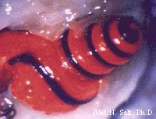
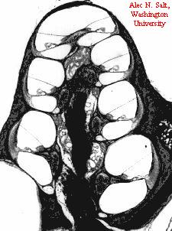
Cochlear Analysis and
Representation of Sound
Basilar membrane
displacements
Information in
Average response rate -
Envelope (E)
&
Temporal-Fine-Structure
(TFS)
Cochlear axis
Frequency (Hz)

Slide 8


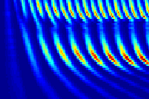
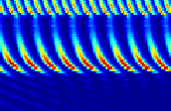
Auditory-Nerve Response
Patterns to Two-Tone Stimulus
average response
4000
2000
1000
500
250
0
Time (
ms
)
60

Slide 11

Fine-Time Structure is used and then discarded towards the cortex
Normal
Down-Shift
Compress
Dilate

Slide 12
Midbrain Temporal Processing
PITCH
In-phase
Random-phase
Unresolved
harmonics
Residue
2000
Pitch
1000
Frequency (Hz)
Musical
Pitch
500
Resolved
Harmonics
250
125
Harmonic series of 75 Hz

Slide 13
Midbrain Temporal Processing
PITCH
In-phase
Random-phase
Unresolved
harmonics
Residue
2000
Pitch
1000
Frequency (Hz)
Musical
Pitch
500
Resolved
Harmonics
250
125
Harmonic series of 75 Hz

Slide 14
Midbrain Temporal Processing
PITCH
In-phase
Random-phase
Unresolved
harmonics
Residue
2000
Pitch
1000
Frequency (Hz)
Musical
Pitch
500
Resolved
Harmonics
250
125
Harmonic series of 75 Hz

Slide 15
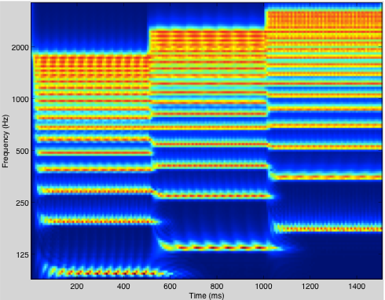
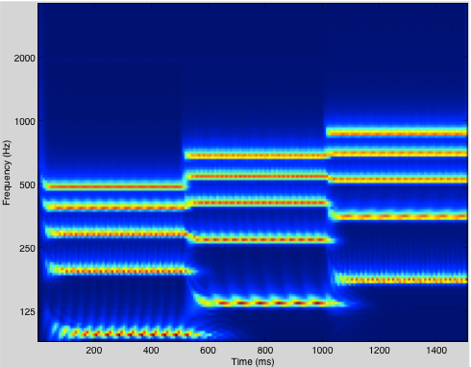
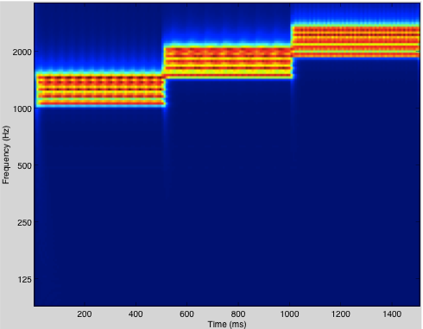
Harmonicity : Musical Pitch
Musical
Pitch
Residue
Pitch

Slide 16
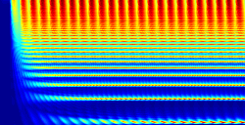
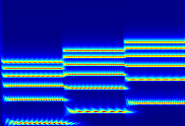
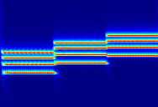
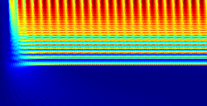
Perceived pitch = Fundamental frequency(regardless!)
Full harmonic series
Missing fundamentals
4000
2000
1000
Frequency (Hz)
500
250
125
Time
Time

Slide 17
Midbrain Temporal Processing
Localization
Detecting Temporal
Disparities

Slide 18
Midbrain Temporal Processing
Network of Neural Delay Lines
Jeffress Model
Network of Coincidence Detectors
Stereausis
Delay axis
−2τ
0
2τ
Ipsilateral cochlea
Delay lines
Auditory-nerve
Coincidence detectors
Residue
Auditory-nerve
Pitch
Sound
Contralateral cochlea
Two ways to exploit the temporal disparities to localize the sound

Slide 19
The Biological Bases
of
Auditory Scene Analysis

Slide 20
Auditory Processing
Analyzing sounds in complex reverberant environments requires :
Extracting the spectrum of incoming sounds
Estimating the pitch of concurrent sources
Localizing and tracking them accurately
Perceiving and recognizing their timbre

Slide 21
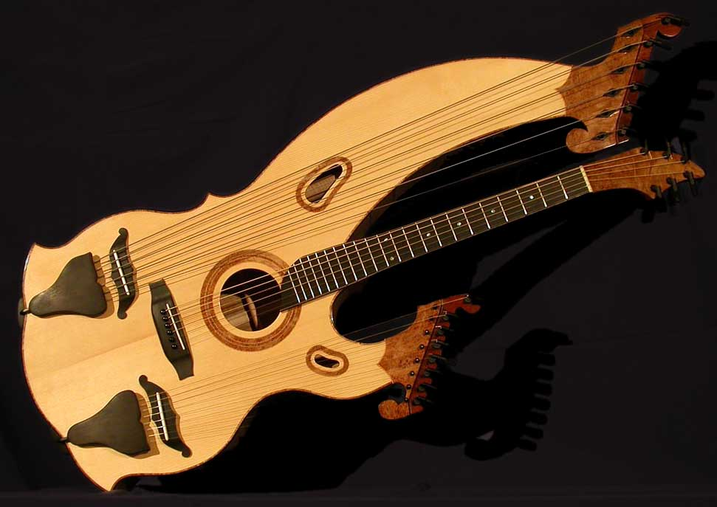
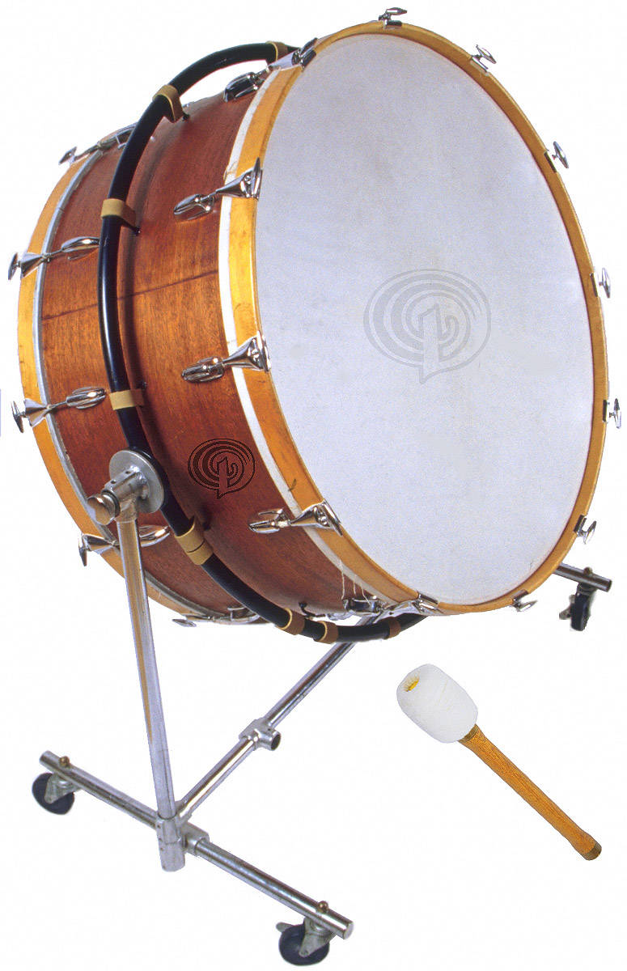
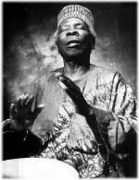

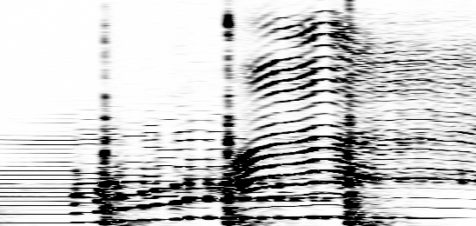
An auditory scene
Frequency
Time

Slide 22
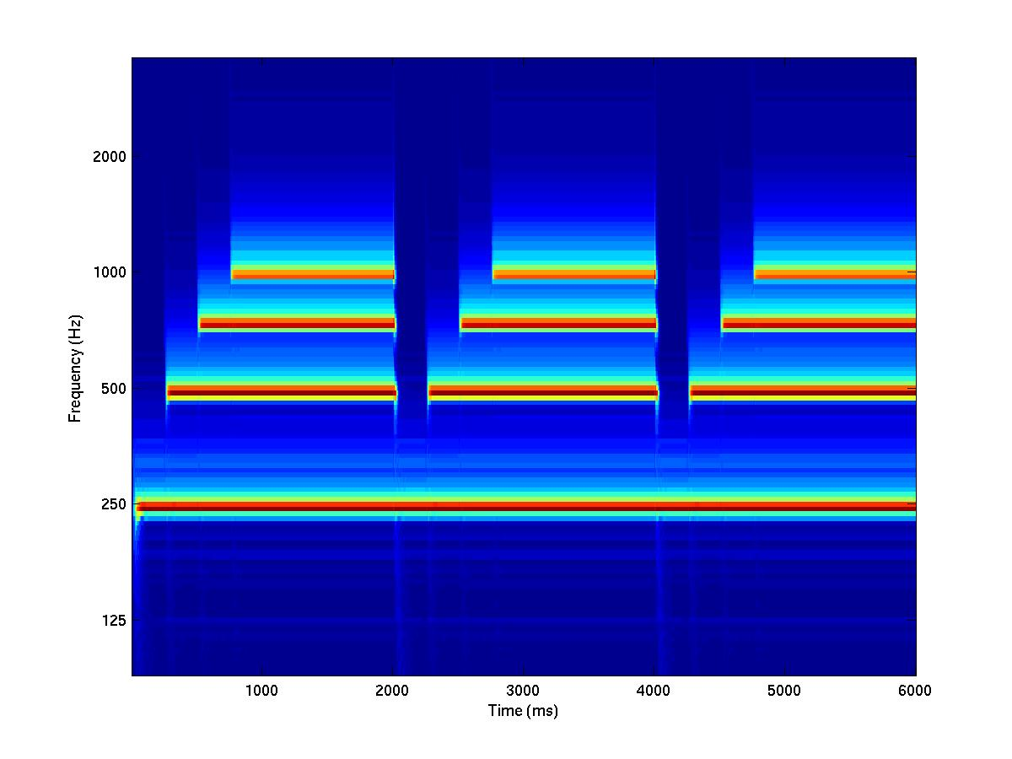
Onsets are Salient

Slide 23
Fine-Time Structure is used and then discarded towards the cortex
Normal
Down-Shift
Compress
Dilate

Slide 24
Simultaneous cues help perception of speech
Sinewave Speech
F3
S1
Frequency (Hz)
F2
S2
F1
Pulsed Sinewave speech
F3
S1-pulsed
Frequency (Hz)
F2
S2-pulsed
F1

Slide 25
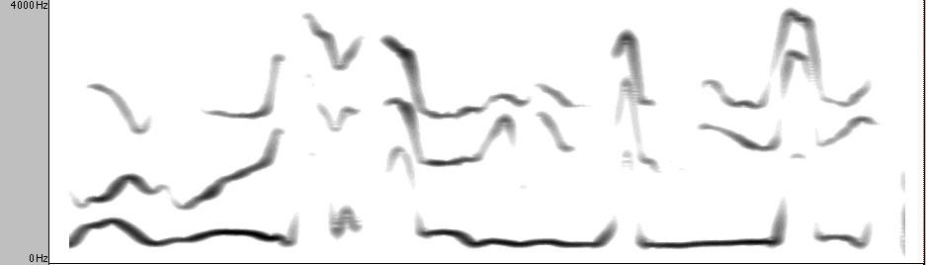
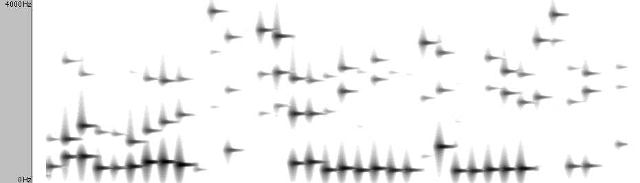
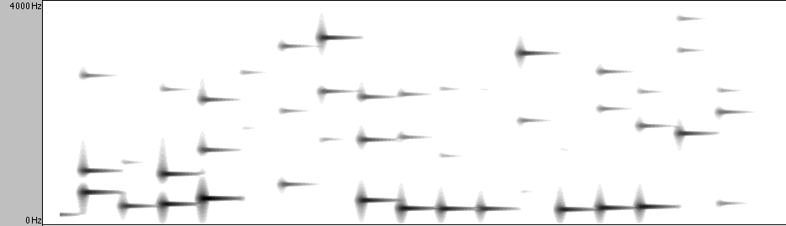
Speech Music
Courtesy of Dr. Chris Darwin

Slide 26
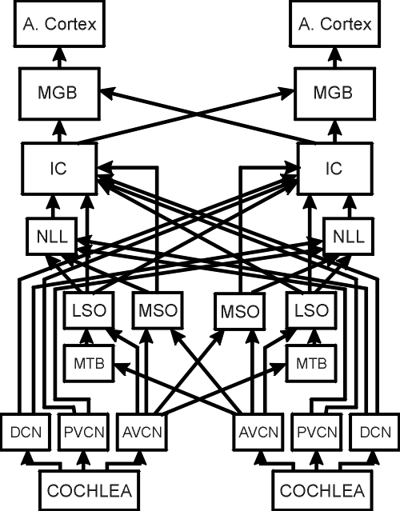
A
n
a
t
o
m
y
o
f
t
h
e
A
u
d
i
t
o
r
y
S
y
s
t
e
m
Model of Auditory Pathway
Cortex
Slow
MGB
Thalamus
IC
Midbrain
N
L
L
L
L
Binaural Nuclei
Cochlear Nucleus
T
B
D
C
N
P
V
C
N
Fast
A
V
C
N
Notes:
Cells RFs become more complex adding new dimensions

Slide 27
Experimental Set-up

Slide 28
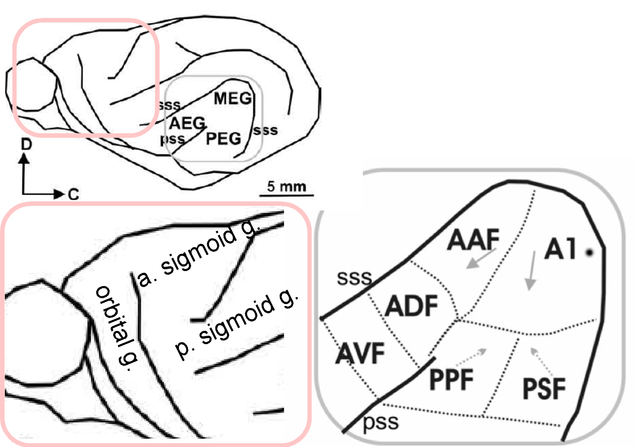
The Ferret Auditory and
Frontal Cortex
TOP
DOWN

Slide 29
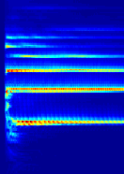
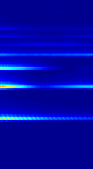
Spectro-Temporal Modulations
Temporal
Temporal
Spectral
Spectral
Frequency
Frequency
Violin
(vibrato)
Piano
time
time
Amplitude
Frequency
Frequency

Slide 30
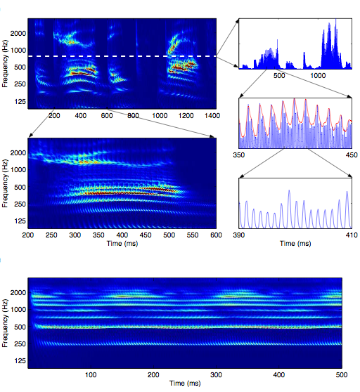
The Temporal Scales of Speech
Slow
Primary Auditory
Cortex - AI
Midbrain - IC & MGB
Auditory Nerve &
Cochlear Nucleus
Fast
Spectro-Temporal
Modulations of
Speech

Slide 31






Decomposing a Spectrogram into Dynamic Ripples
Frequency
w =
4 Hz
∆
A
Time
0
Σ
1
2
4
8
1
6
F
r
e
q
u
e
n
c
y
(
k
H
z
)
0
t
(
ms
)
250
5
Time (ms)
0.6
250
0
Frequency
0.2
-12
-4
4
12
Rate (Hz)

Slide 32
Experimental Set-up

Slide 33
Spectro-temporal Receptive Fields (STRFs)
broad
bandwidth
Oriented
(FM)
time
time
time
narrow
bandwidth
fast
sluggish
time
time
time

Slide 34
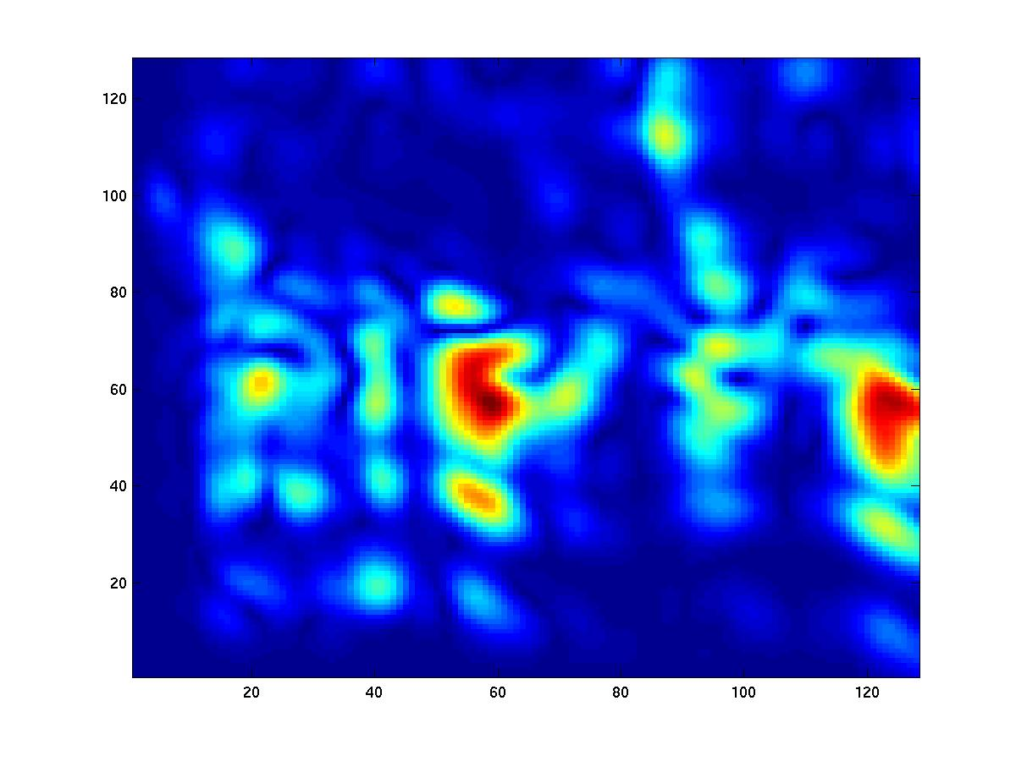
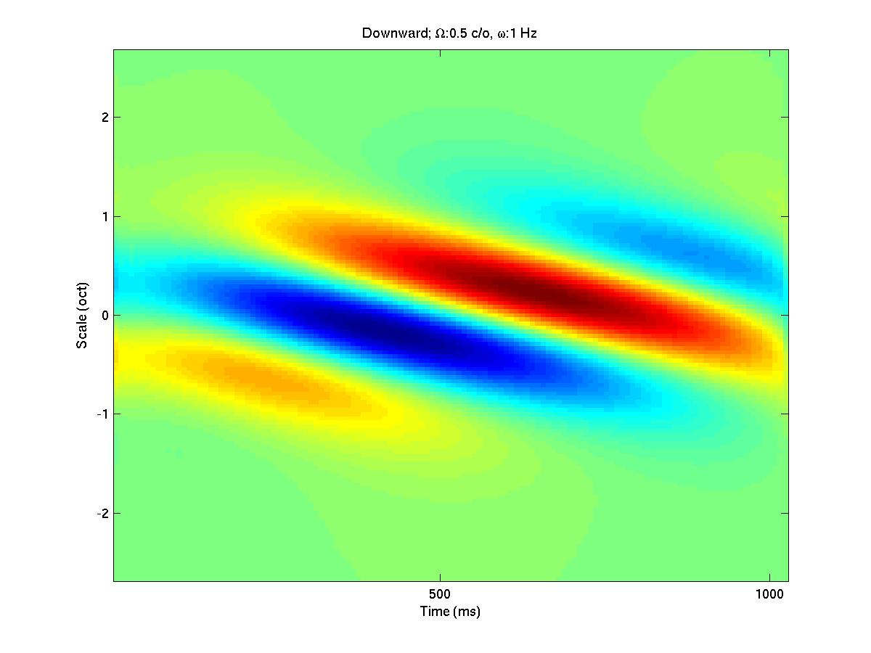
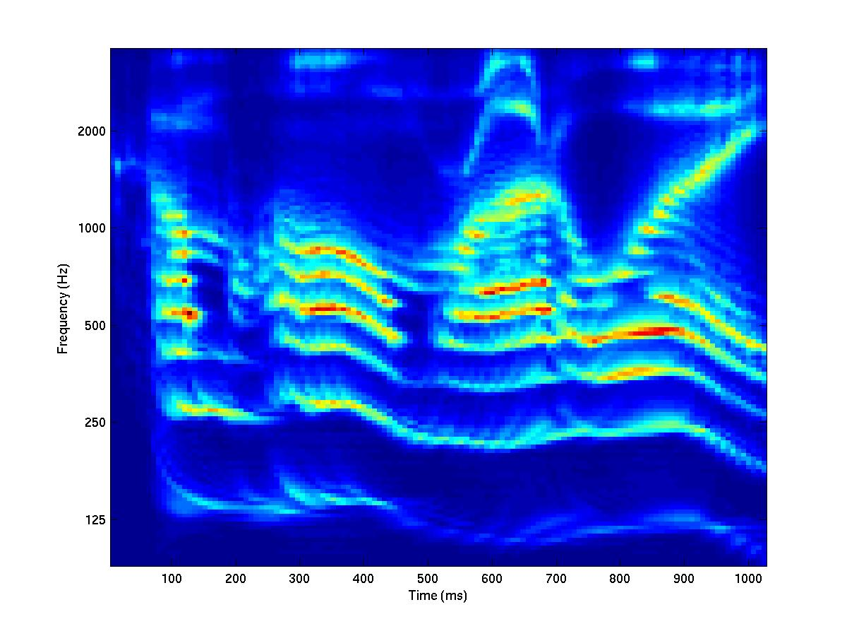
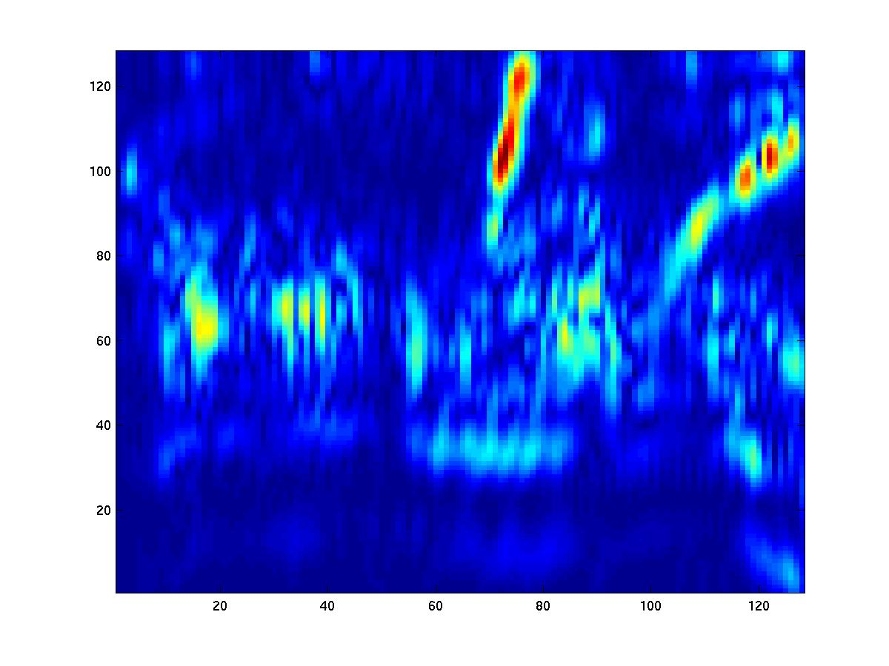
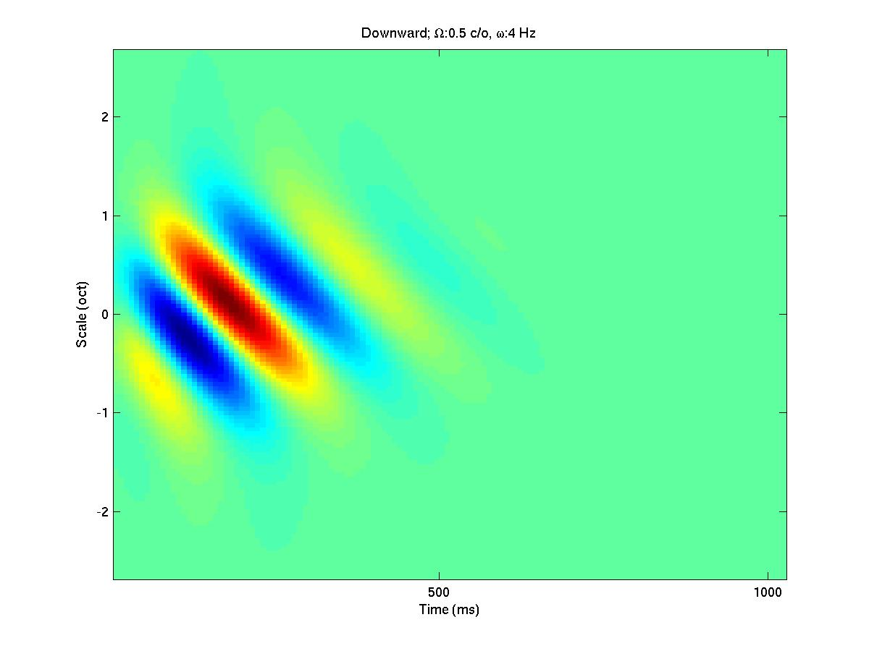
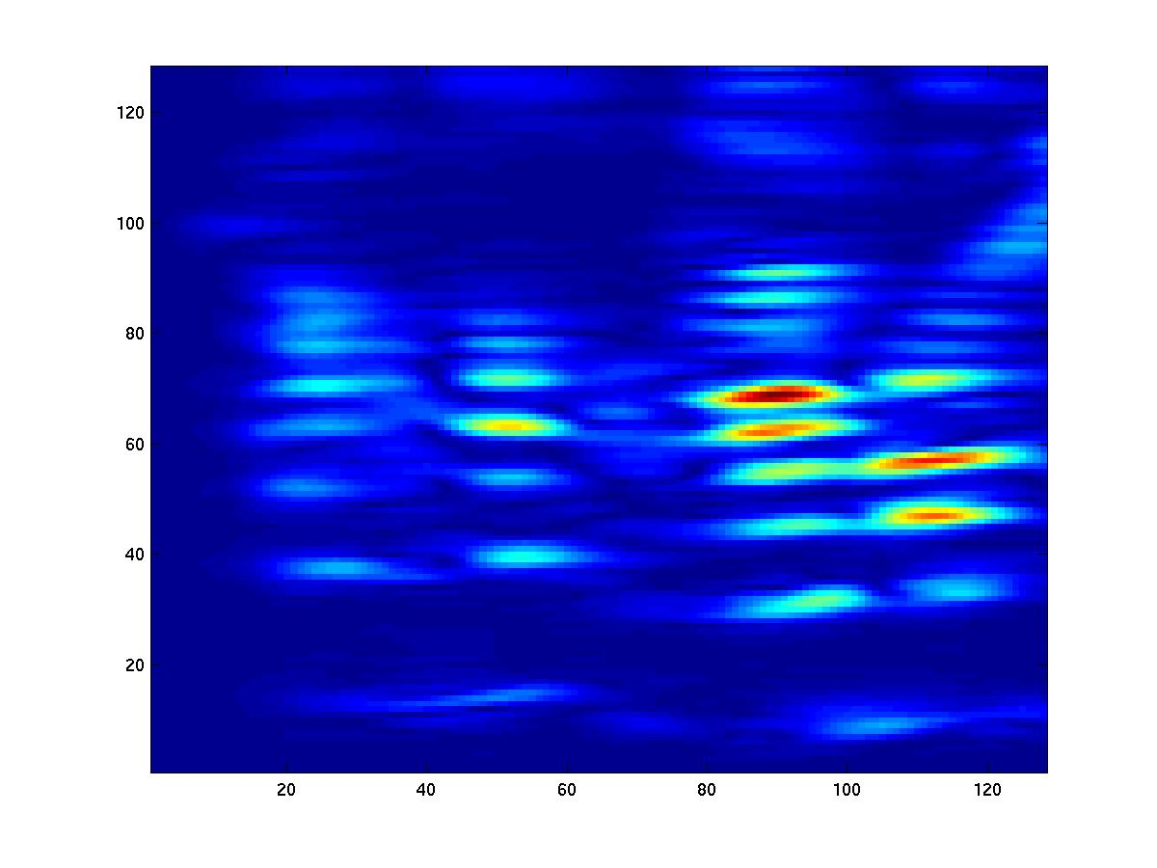
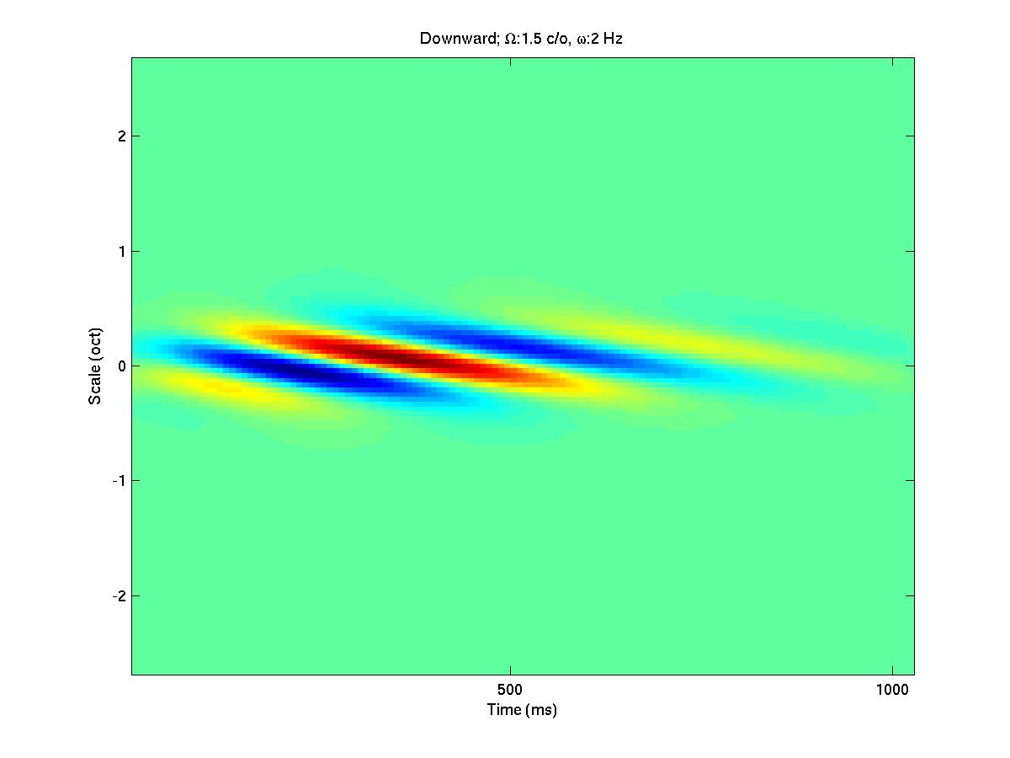
Cortical Views of the
Auditory Spectrogram
Cortical Spectrograms
STRFs
Slow / Wide BW
Auditory Spectrogram
vowels & broad
energy foci
Fast / Wide BW
transients &
up transitions
Slow / Narrow BW
Harmonics

Slide 35
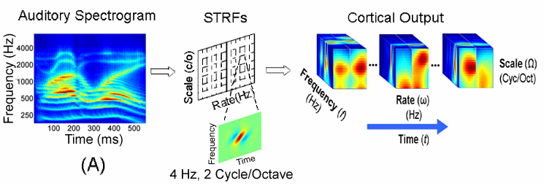
Cortical Multiresolution Representation
Cortical Multiscale Representation
A sequence of two “wavelet transformations”
Sound → Auditory spectrogram → Cortical 2D transformation
It is analogous to “Cepstral Analysis” - with a difference: Local and Multiscale

Slide 36
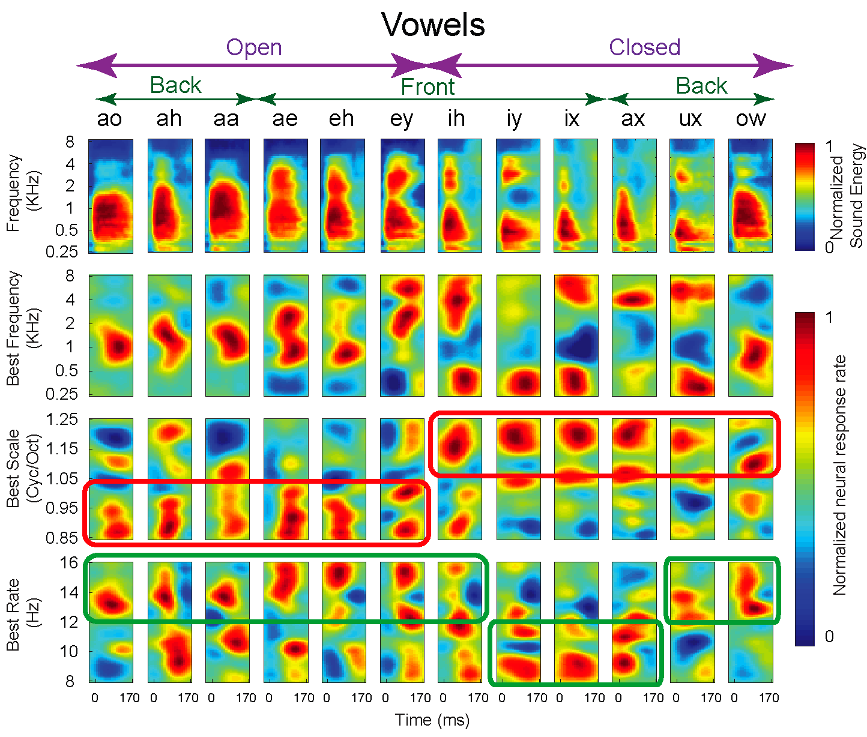
Input
Frequency
Response Dimensions
Bandwidth
Speed
91 neurons

Slide 37
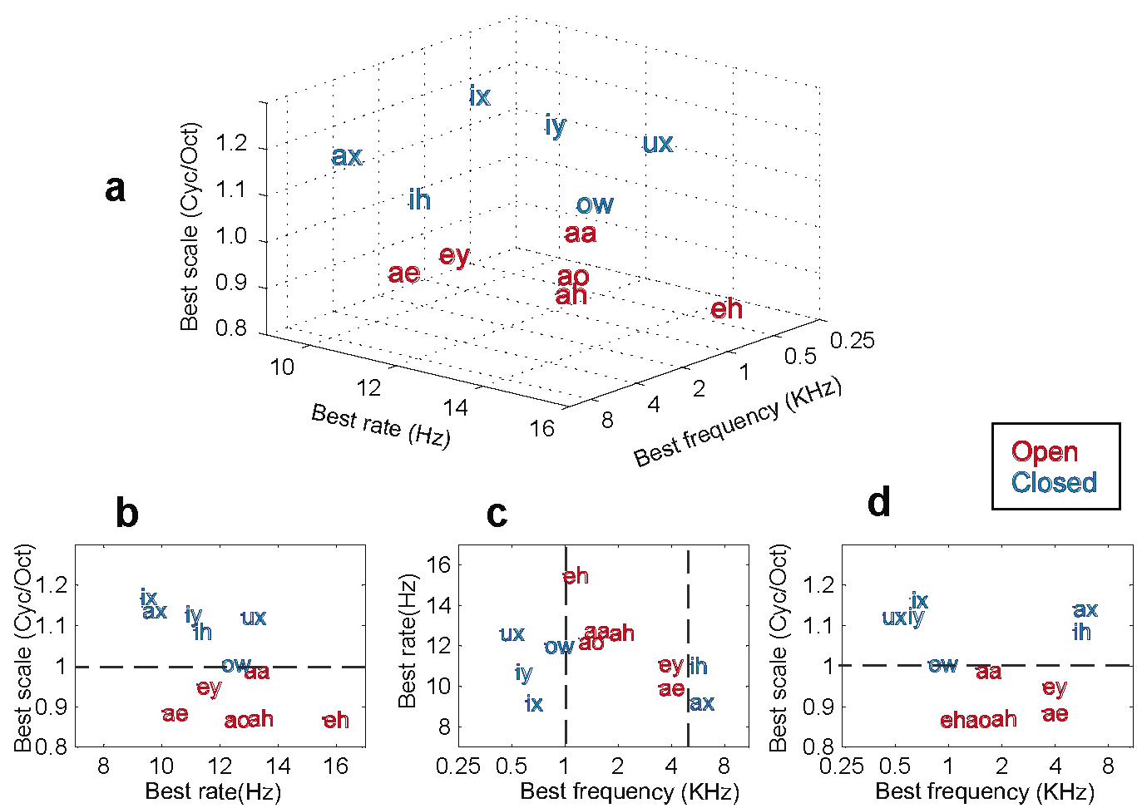
Clustering of Vowel Responses
Bandwidth - Speed
Speed - BF
Bandwidth - BF

Slide 38
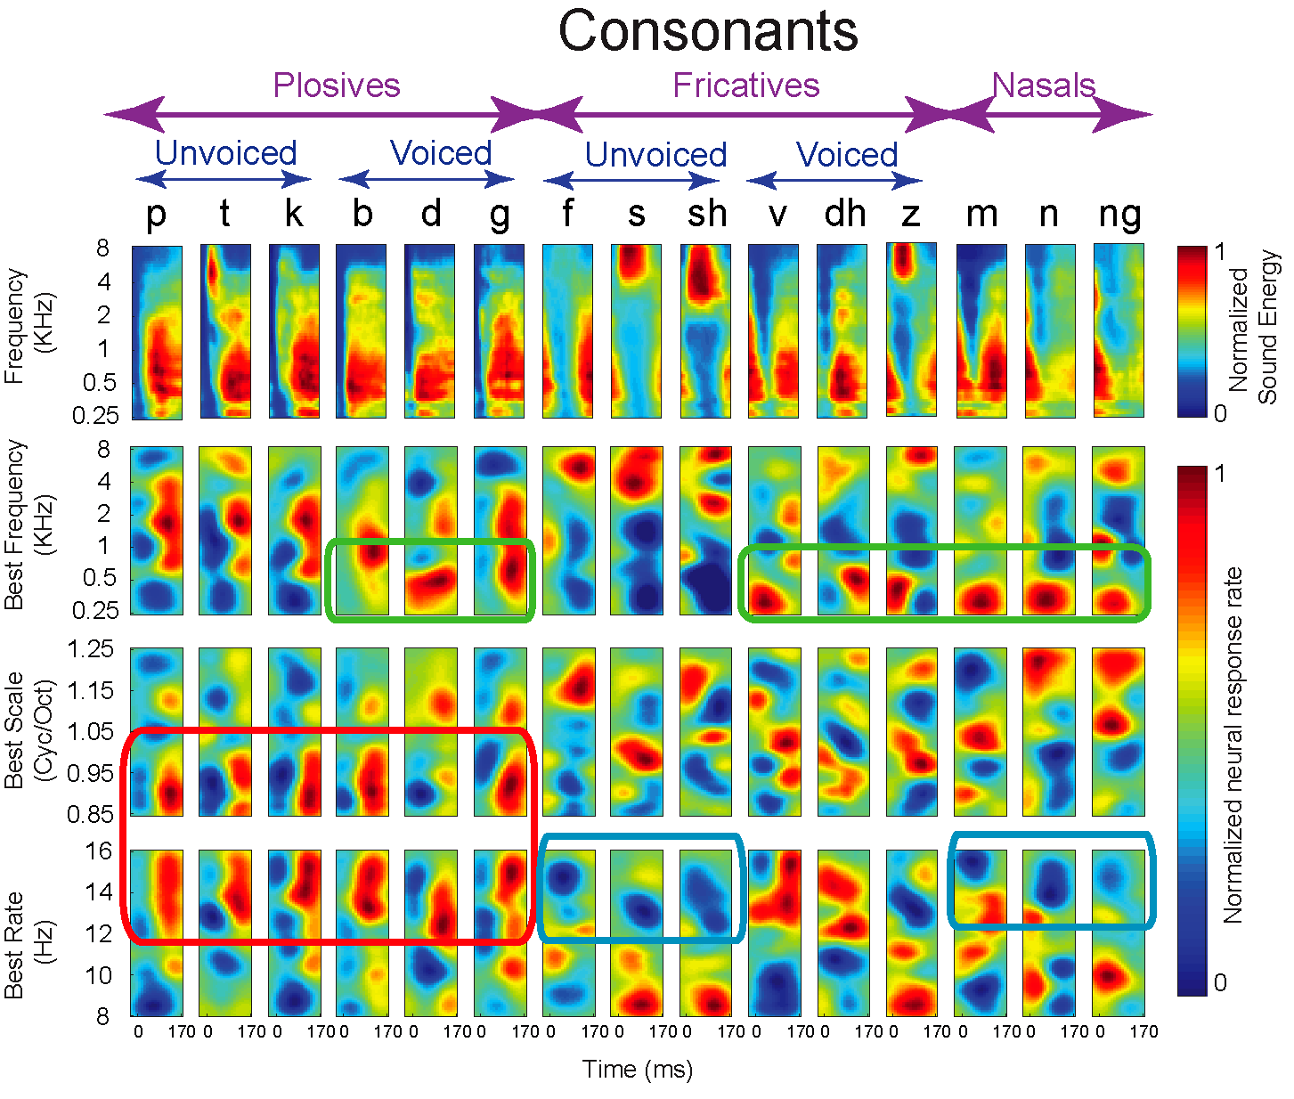
Frequency
Bandwidth
Speed
91 neurons

Slide 39
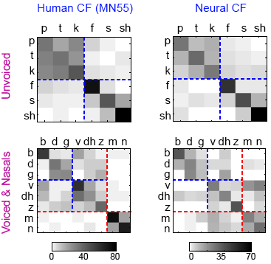
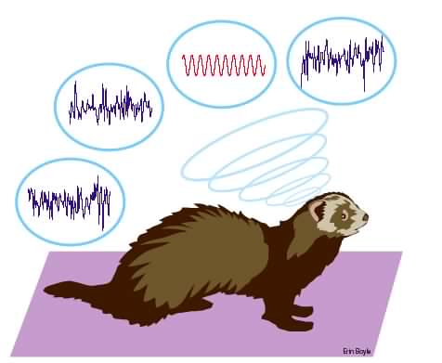
Phoneme
Confusion
Matrices
^%#@*$
....
is that an
s or T ??????
Neural Responses
Versus
Human Perception

Slide 40
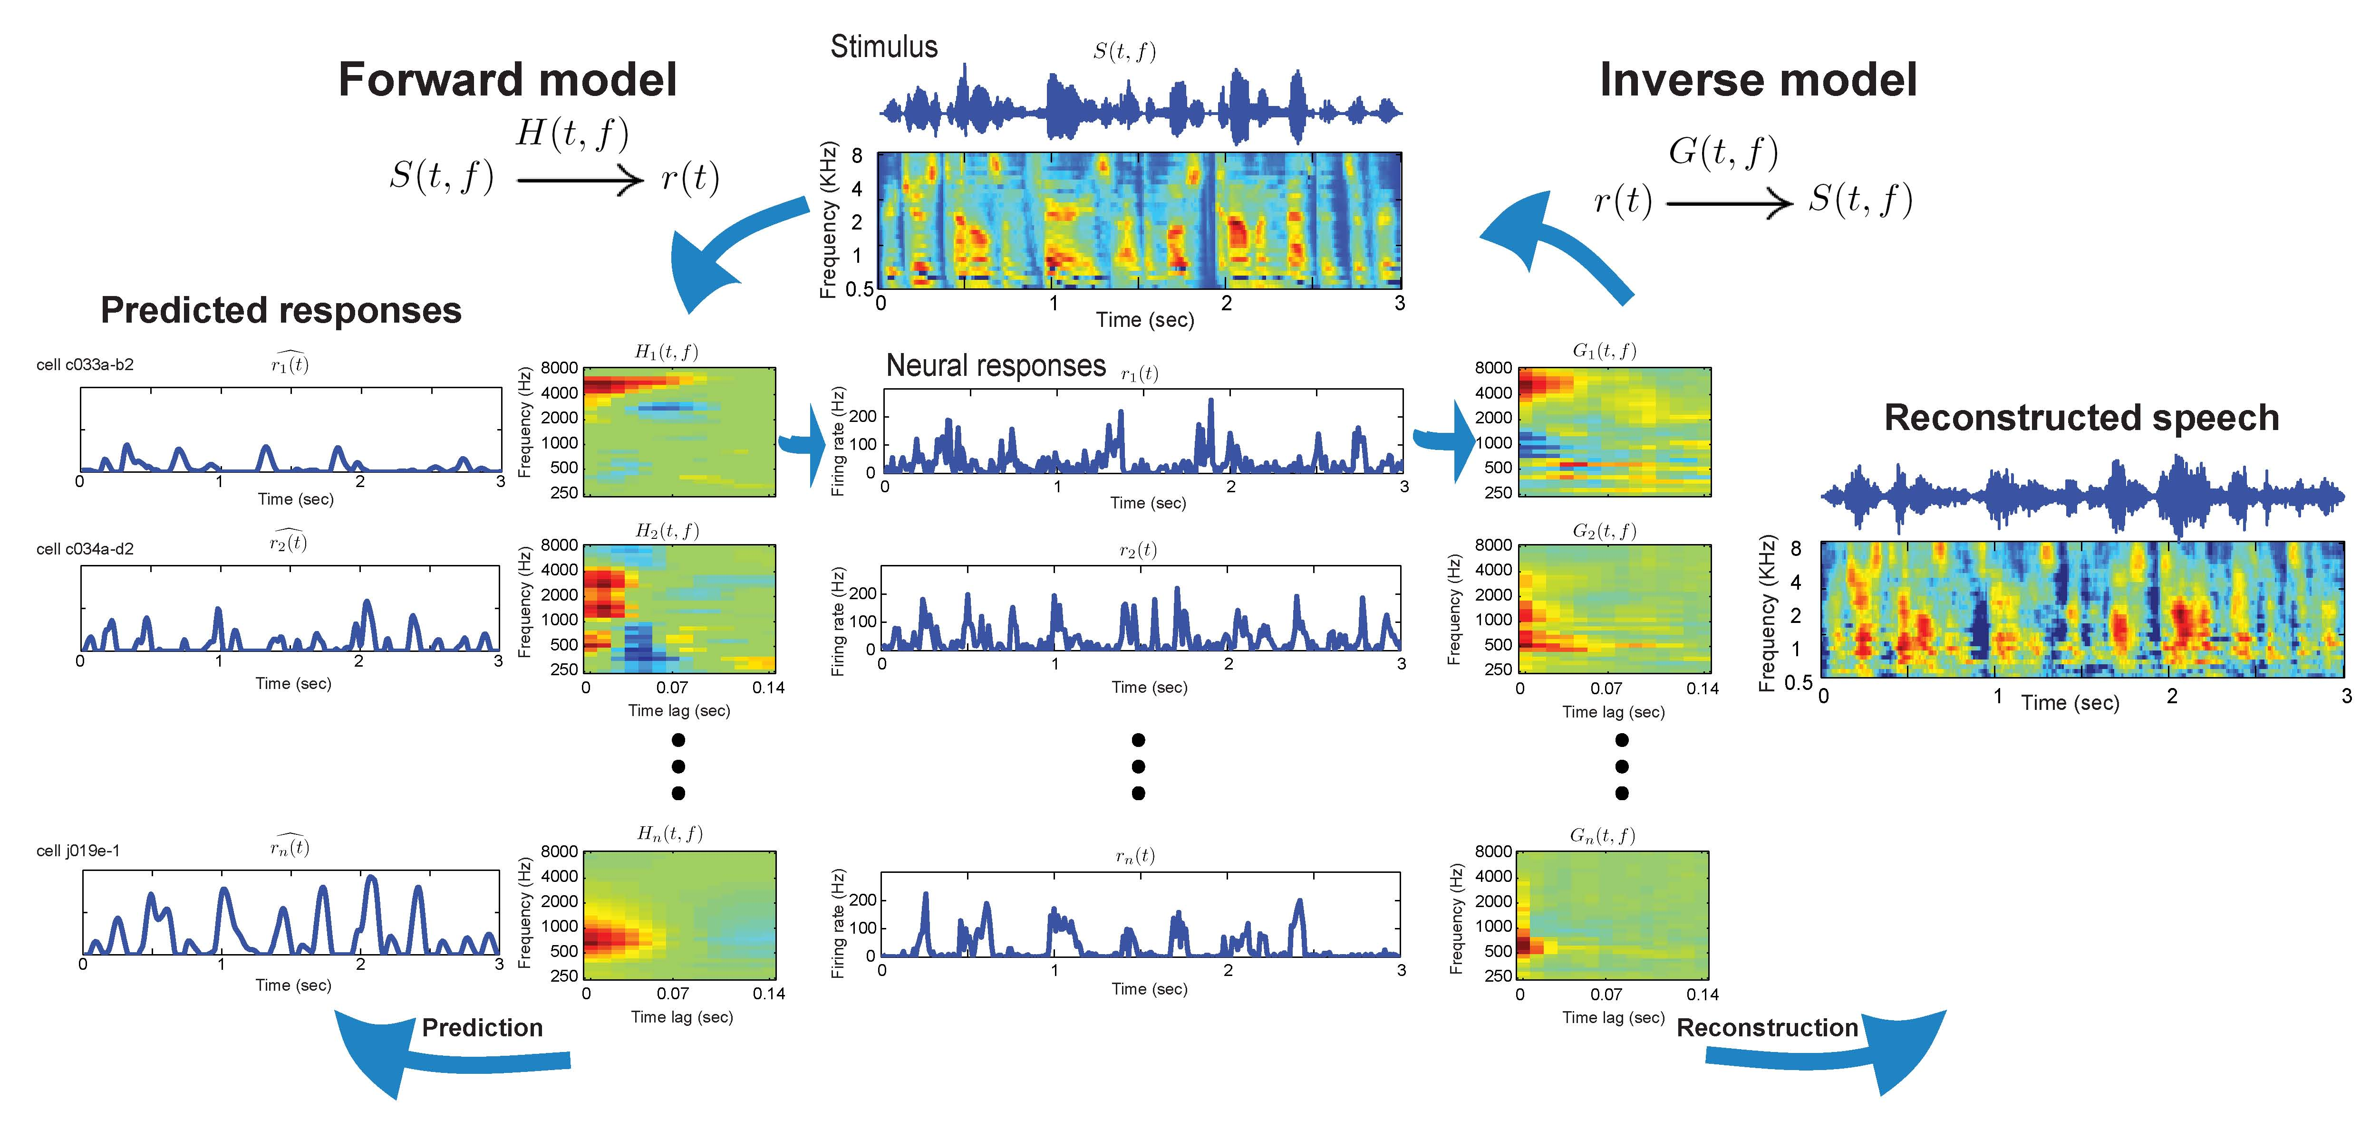
The Inverse Model for Reconstruction
Original
Reconstructed
(<100 neurons)

Slide 41
Using the Cortical Representation

Slide 42
Spectro-temporal Analysis of Speech
&
Other Complex Sounds

Slide 43
Representation of Speech Dynamics

Slide 44
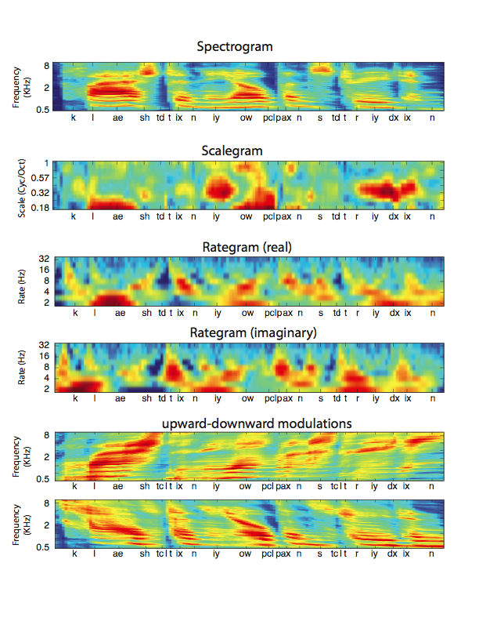
Frequency
Clashed in the open street and
Bandwidth
Clashed in the open street and
Rategram
(Dynamics)
Dynamics
Clashed in the open street and

Slide 45
Clashed in the open street and
(Spectral shape or Bandwidth)
Diffuse
spectra
Compact
spectra
Clashed in the open street and
Rategram
Clashed in the open street and

Slide 46
Clashed in the open street and
Clashed in the open street and
Rategram
(Dynamics)
fast
events
sustained
events
Clashed in the open street and
mixed
events
(dipthongs)

Slide 47
Perceptual Investigations

Slide 48
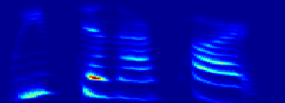
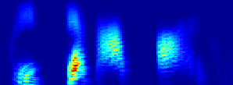


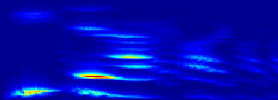
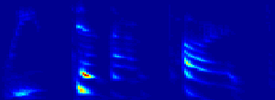


Manipulating Temporal and Spectral Modulations
Normal
Spectrally smeared
2
0
0
0
2
0
0
0
1
0
0
0
1
0
0
0
5
0
0
5
0
0
2
5
0
2
5
0
1
2
5
1
2
5
1
0
0
2
0
0
3
0
4
0
5
0
0
6
0
7
0
8
0
0
9
0
1
0
0
0
1
0
2
0
3
0
4
0
5
0
6
0
0
7
0
8
0
0
9
0
1
0
0
0
0
0
T
i
m
e
0
0
0
0
0
0
0
T
0
0
0
i
(
m
s
)
(
m
e
Temporally smeared
m
s
)
Temporally sharpened
2
0
0
0
2
0
0
0
1
0
0
0
1
0
0
0
5
0
0
5
0
0
2
5
0
2
5
0
1
2
5
1
2
5
1
0
0
2
0
0
3
0
4
0
5
0
0
6
0
0
7
0
8
0
9
0
1
0
0
0
1
0
0
2
0
3
0
0
4
0
5
0
0
6
0
7
0
0
8
0
9
0
1
0
0
0
0
0
T
i
m
e
0
0
0
0
0
T
i
m
e
0
0
0
(
m
s
)
(
m
s
)

Slide 49
Different types of information are carried by different scales
Envelopes
(wide bandwidths
- low scales)
+
Fine structure
(narrow bandwidths
- high scales)
Morph
Voices

Slide 50
Intelligibility Assessment
&
Audio and Speech Classification

Slide 51
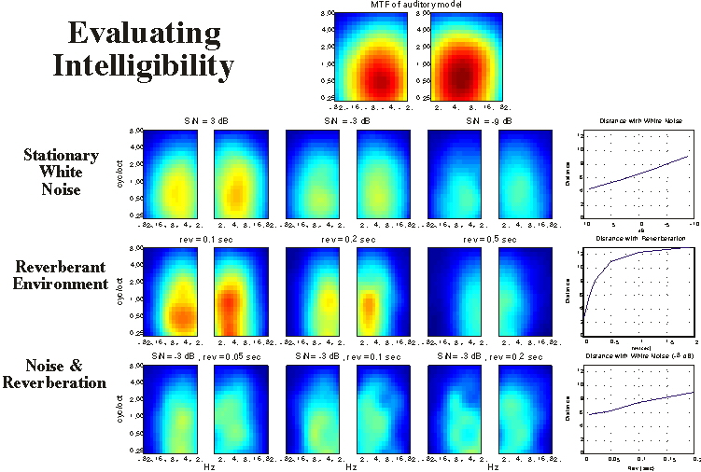
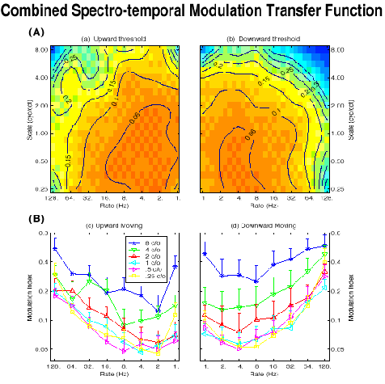
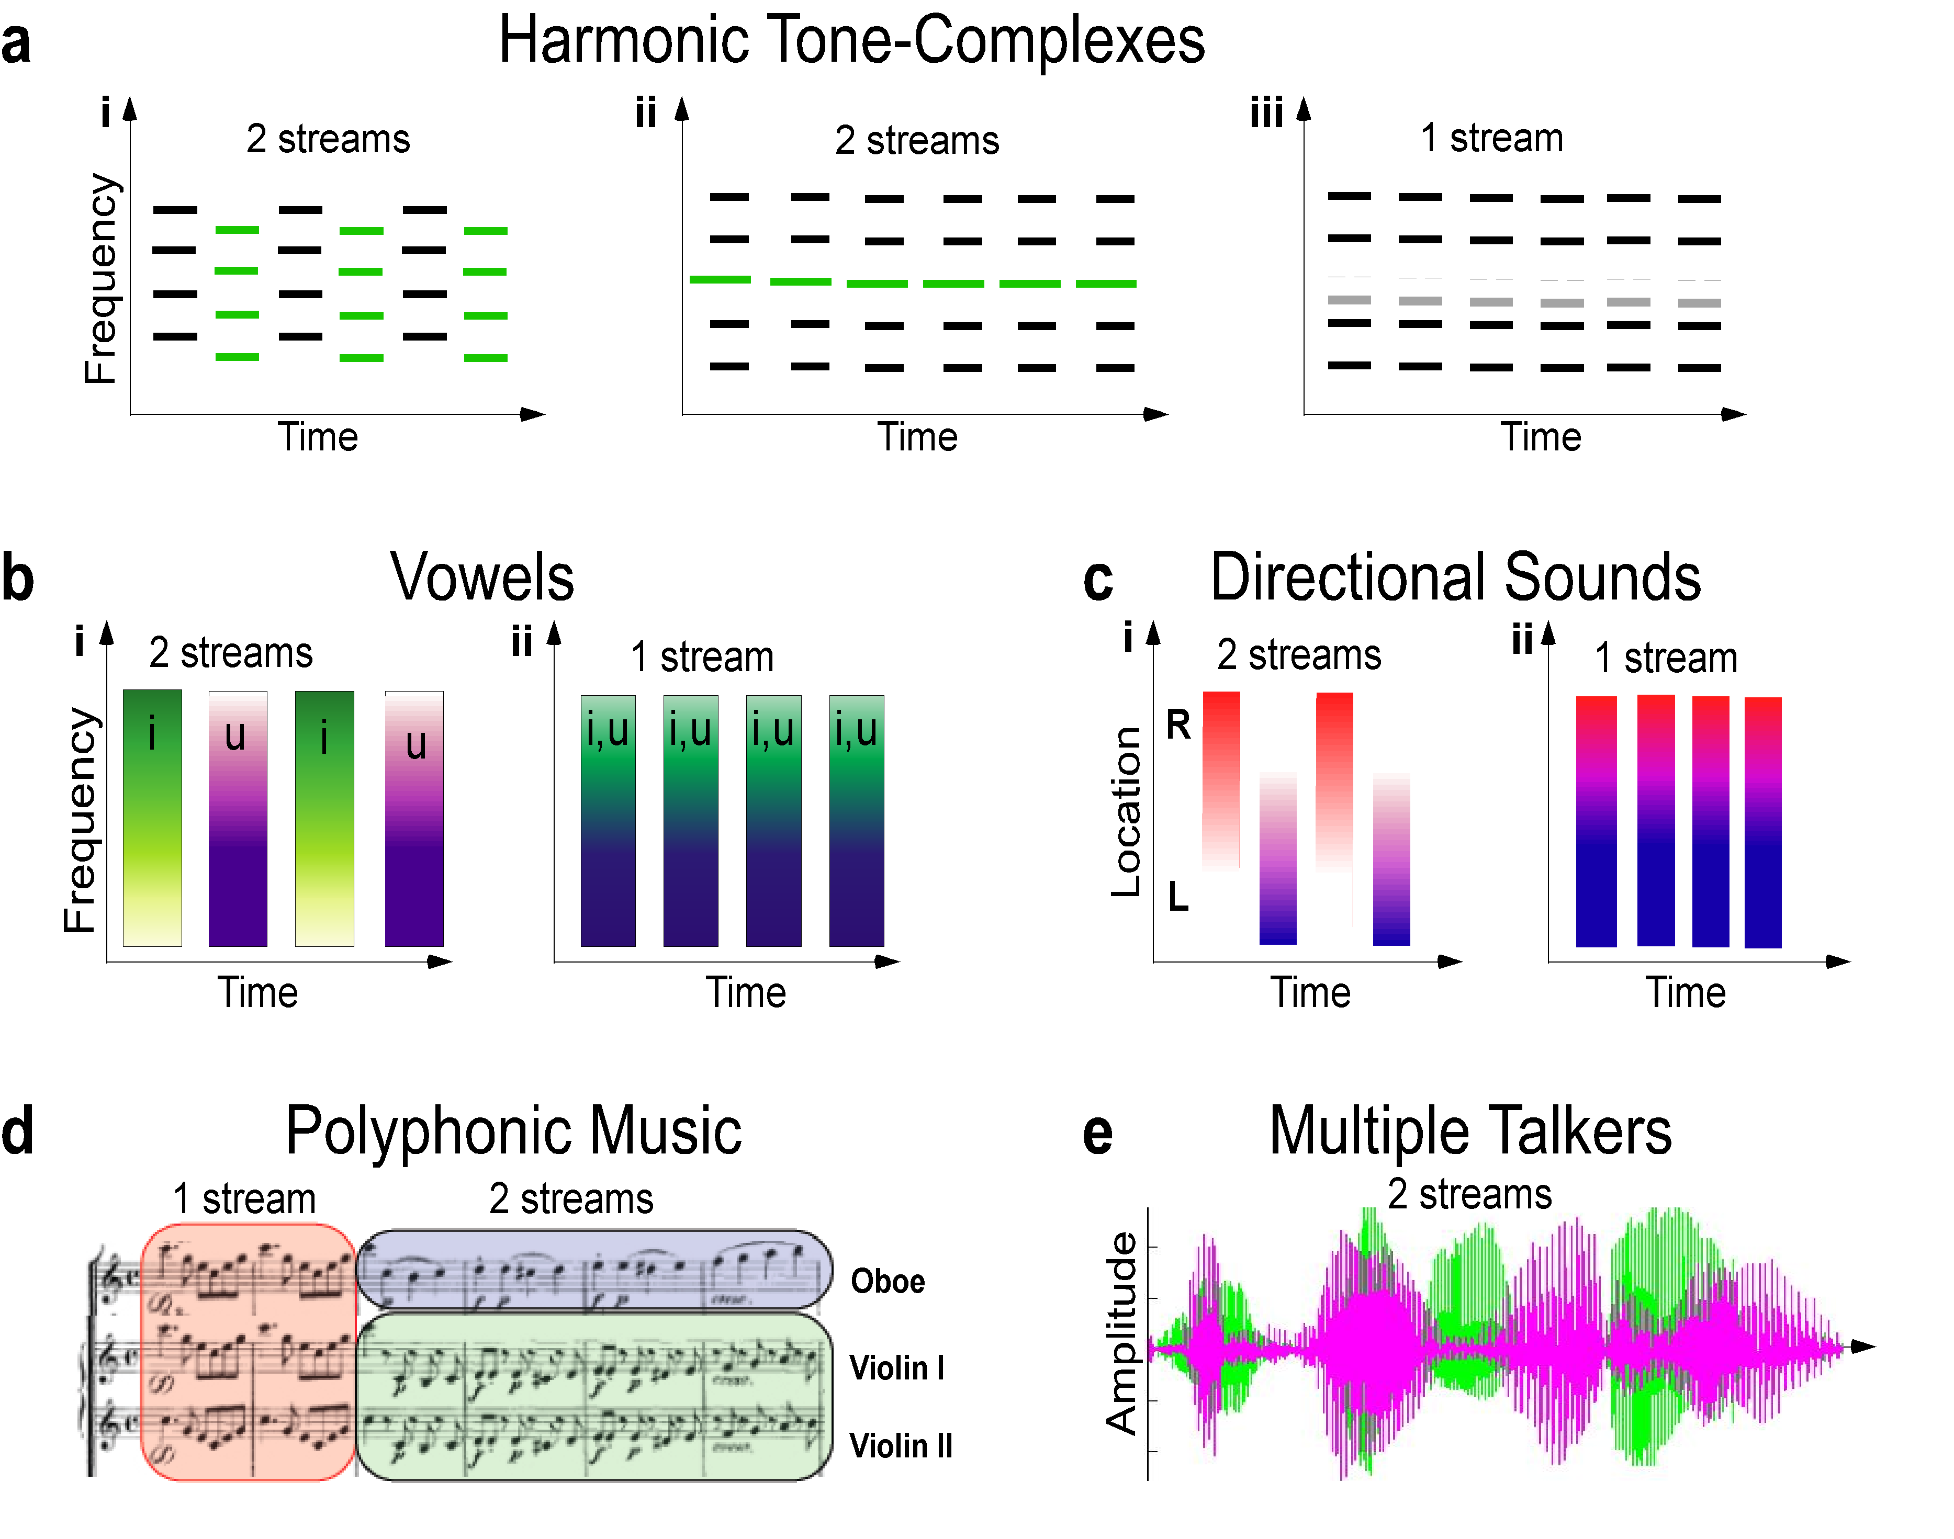
Discriminating Speech and Non-Speech
... using an SVM or a linear regularized least squares classifier directly on the high-dimensional cortical representation.
... state-of-the-art performance.
... is conceptually simple and computationally fast .
... optimal classifier for noisy data can be built using clean data.
Also Sound Coding and Segregation in Hearing Aids
Cortical
Model
Classifier:
Speech?
Yes
no

Slide 52
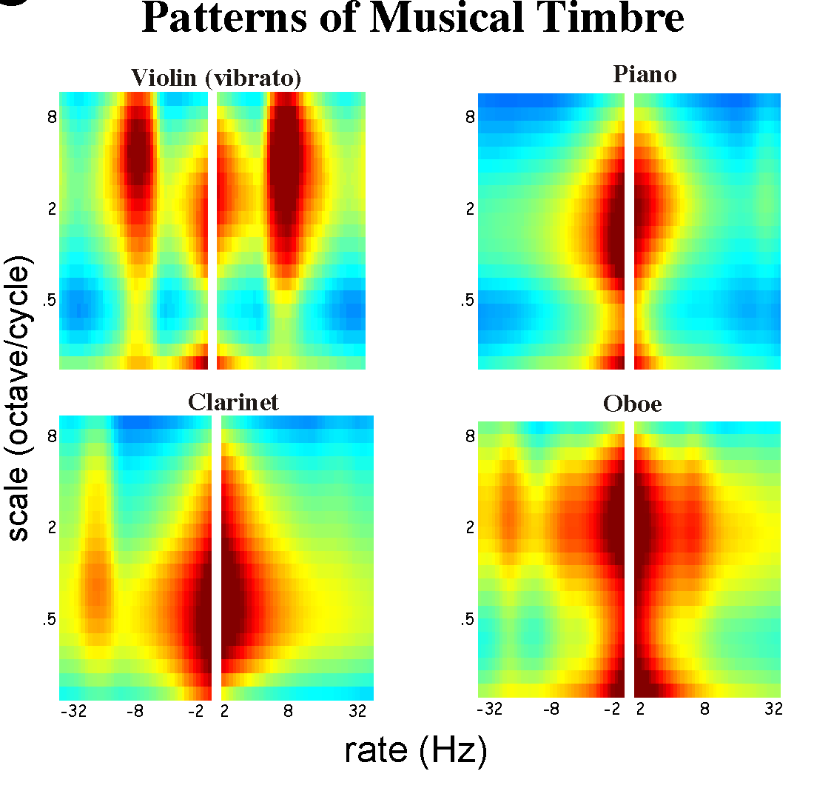
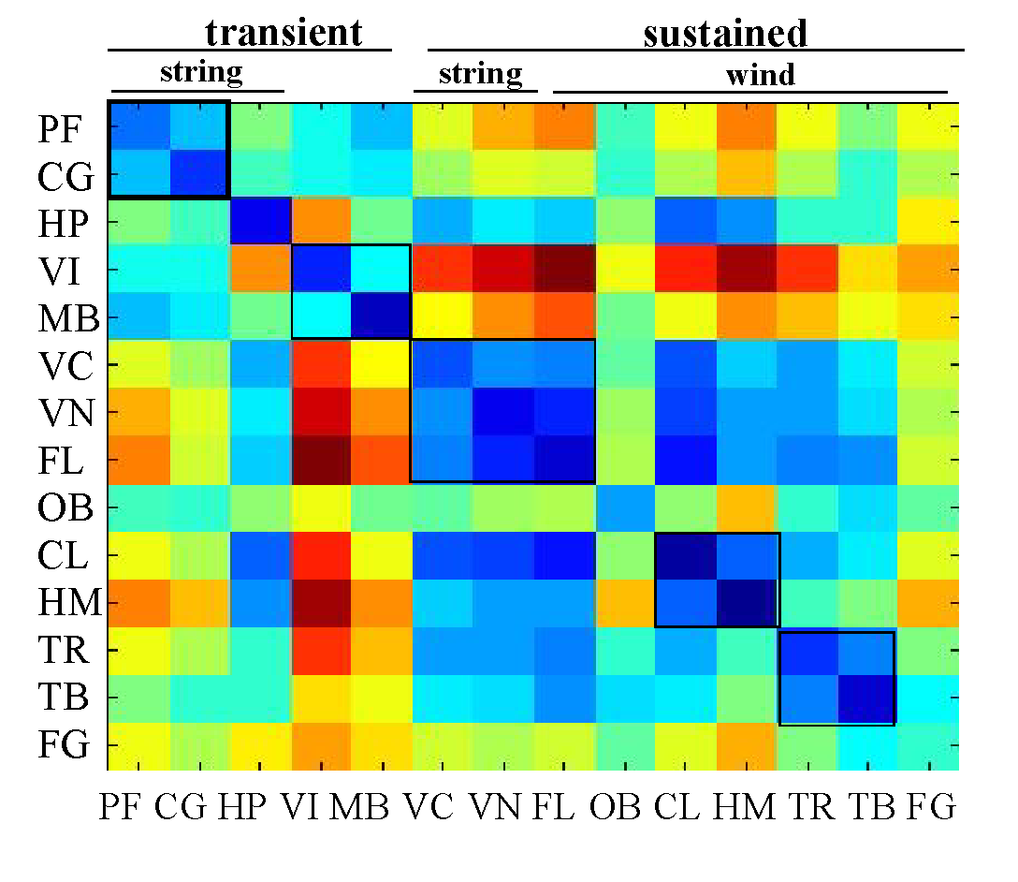
Classifying
Sounds
Musical Confusion Matrix
Daniel
Pressnitzer

Slide 53
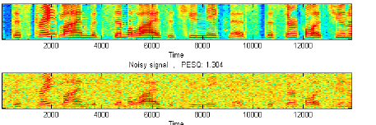
Noise Suppression & Speech Enhancement
Scalar or tapped filter
Noisy Samples
rate
Clean Versions
forward
inverse
Auditory Spectrogram
Trained weights
scale
This mimics our ability to attend and adapt the STRFs in
different regions of the cortical map to achieve a goal
Babble Noise
Nonlinear Noise
Jet Noise

Slide 54
The Adaptive Auditory Mind
Rapid Plasticity

Slide 55
The Adaptive Auditory Mind
Rapid Plasticity
Top-Down

Slide 56
Attention & Cortical Plasticity
During task performance, A1 receptive fields rapidly adapt to change their spectral tuning or dynamics. These changes are in accord with ongoing task expectations (top-down) and salient sensory cues (bottom-up).

Slide 57
The Shepard Tones Illusion
Biasing
Testing
T1
T2
Transition
Frequency (tonotopic axis)
. . .
Time
Time
Claire Chambers
Daniel Pressnitzer

Slide 58
The Shepard Tones Illusion
Biasing
Testing
T1
T2
Transition
Frequency (tonotopic axis)
. . .
Time
Time
Daniel Pressnitzer

Slide 59
The Shepard Tones Illusion
Biasing
Testing
T1
T2
Transition
Frequency (tonotopic axis)
. . .
Time
Time
Daniel Pressnitzer

Slide 60

Auditory-Visual Contexts

Slide 61
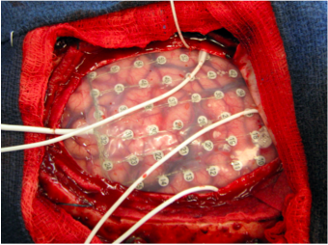

Human Recordings and Reconstructions
Electrocorticography (Ecog)
Nima Mesgarani and Eddie Chang (UCSF)
Implanted chronic grids for localization of epileptogenic foci usually 7-10 days. UCSF hospital
Placement of 256 electrodes

Slide 62


Slide 63



Original Female
Original Male

Slide 64
Extracted from the Same Mixture Stimulus
+
Original Female
Original Male

Slide 65
Experimental Set-up
Aversive and Appetitive Tasks

Slide 66



Tone Detection Task
Aversive
Reference
Target
Behavior is
essential for
plasticity
Population
Average

Slide 67

STRF changes in a series of click discrimination tasks

Slide 68


Slide 69


AI Plasticity depends on target meaning
Similar stimuli, but opposite actions, induce opposite plasticity!
Aversive Task
Appetitive Task
Enhancement
Suppression
Stephen David
Suppression of instinctive behavior
Optimizing reward or aversive feedback

Slide 70
Beyond A1

Slide 71
The Ferret Auditory and
Frontal Cortex
A1 PEG PFC

Slide 73




The PEG – A halfway station ?
Normal Tuning curves
Complex or noisy STRF’s
“Pseudo- Categorical” Responses
to Target & Reference signals
PFC > PEG > A1

Slide 74



PPF
No differences
PSF
PSSC
PSSC

Slide 75



PFC - Categorical Responses
Prefrontal cortex
(PFC)
A1
Direct anatomical projections
Behavior is essential
Responses persist after behavior
Rich variety of response patterns (+ve and -ve)
Abstract responses reflecting meaning (not physics) of stimuli
Time (s)
Jonathan Fritz
Stephen David

Slide 76


Sensory vs Motor Activity in PFC
Sensory ?
PFC responses are also multimodal
Cells may respond to acoustic and light targets
Motor ?
Sensory ?

Slide 77






STRF Changes Induced by PFC Stimulation
Target
2-photon
imaging
Patrick Kanold
Dan Winkowski)
Pairing
No-pairing

Slide 78
Long-term memory (as opposed to discrimination) tasks
Speech representation and detection
Expectations, illusions, switching of meaning, … Luckily ferrets
are smart enough to perform all such tasks

Slide 79
Temporal Coherence
and
Perceptual Reorganization
of
Streams

Slide 80
One Stream
Frequency
B
B
…
…
A
A
A
A
Time

Slide 81
Two Streams
Frequency
B
B
…
…
A
A
A
A
Time
Note: when streamed, the relative timing between A and B tones
becomes less important.

Slide 82
Streaming depends on continuity
Frequency
B
B
B
B
…
…
A
A
A
A
B
B
B
B
…
…
A
A
A
A
Time

Slide 83


Motivation
What is the computational basis of stream segregation?
Alternating Sequence
Synchronous Sequence
Population of
B-neurons
Population of
A-neurons
Hypothesis:
  Neural responses to synchronized sequence become overlapped
or
  Additional mechanism exists to signal temporal synchrony

Slide 84





Speech Mixtures
male speaker
pitch
female speaker
male
female
location
left
right

Slide 85


Two-tone sequences
Alternating
A
How are Correlations computed ?
B
time
How does binding happen ?
Synchronous
What is the role of attention ?
A
B
How do streams arise ?
time

Slide 86


How are correlations computed ?
Tone sequences
Correlation
matrix
Alternating
A
-
-
B
-
time
Synchronous
A
+
+
B
+
time

Slide 87
How does binding happen ?
Tone sequences
Correlation
matrix
Neural
implementation
Alternating
A
-
-
B
-
time
Rapidly
adapting
connectivity
Synchronous
A
+
+
B
+
time

Slide 88


How do streams arise ?
Tone sequences
Correlation
matrix
Neural
implementation
‘Mask’
Alternating
A
-
A
-
B
-
Selective
attention
B
time
Rapidly
adapting
connectivity
Synchronous
A
+
A
+
B
+
Selective
attention
B
time

Slide 89
Mathematical Realizations
A
Correlation
matrix
Eigenvectors
Eigenvalues
Eigenvectors
e₁
B
λ₁
e₁
λ₂
…
-
…
-
A
-
…
B

Slide 90
Mathematical Models
Correlation
matrix
Eigenvectors
Eigenvalues
A
Eigenvectors
e₁
λ₁
e₁
λ₂
B
…
-
…
-
A
-
…
B
e₁
e₁
Neural
Implementation
A
B
A-stream
A
B
PCA
or
nPCA
λ₁
input
λ₂
output
e₂
B-stream
e₂
Auto-Associative Neural Networks
or
Auto-Encoders

Slide 91
Mathematical Models
Correlation
matrix
Eigenvectors
Eigenvalues
A
Eigenvectors
e₁
λ₁
e₁
λ₂
B
…
-
…
-
A
-
…
B
e₁
e₁
Neural
Implementation
A
B
A-stream
A
B
PCA
or
nPCA
λ₁
input
λ₂
output
e₂
B-stream
e₂
Selective Attention
e₁
e₁
Selective
Attention
for readout
and for learning
PCA
or
nPCA
λ₁
input
output
λ₂
e₂
e₂

Slide 92

Speaker Separation Through Coherence

Slide 93

Auditory figure-ground segregation
using a complex stochastic stimulus
Sundeep Teki Maria Chait
Deborah Williams Aiysha Siddiq
Sukhbinder Kumar Tim Griffiths
7246
Notes:
Chord duration – longer; Frequency separation – longer; ~ streaming

Slide 94




Dramatic
Illustrations
of Objects
through
Coherence
Visual
Motion Silences Awareness of Visual Change
Jordan W. Suchow1,* and George A. Alvarez1
Current Biology V21 No 2
Acoustic

Slide 95
frequency
pitch
left
location
right
female
male
Frequency - scale
Attend to
female
female attention mask
Binding of different attributes
pitch
location
location
pitch
Frequency - scale

Slide 96













Overall Structure
Frequency-scale-pitch-location
Coherence Analysis
frequency
Scale Analysis
Frequency-scale-pitch-location
time
scale
frequency
Attention
time
Pitch analysis
frequency
time
time
Foreground
location
Location analysis
time
Attentional mask

Slide 97








Simulation Results:
Examples of simple stimuli
Reconstructed spectrogram
for perceived stream
Stimulus spectrogram

Slide 98






Speaker Separation Performance (SIR=0dB): memory-based mask formation
Target speaker
Interfering speaker
Mixture
+
=
ρ_{base}
ρ_{seg}
ρ_{conf}
ρ_{base}
ρ_{conf}
Segregated
Spectrogram
of target speaker
ρ_{seg}
Number of utterances
Correlation Coefficient

Slide 99


Speaker Separation Performance (SIR=6dB): attention-based mask formation
ρ_{base}
mix sp1 sp2
mix sp1 sp2
ρ_{conf}
ρ_{seg}
female+male
Number of utterances
Correlation Coefficient
mix sp1 sp2
mix sp1 sp2
female+female
male+male
Number of utterances
Correlation Coefficient

Slide 100


Speaker Separation Performance (SIR=0dB): attention-based mask formation
ρ_{base}
mix sp1 sp2
ρ_{conf}
ρ_{seg}
female+male
Number of utterances
Correlation Coefficient
mix sp1 sp2
female+female
male+male
Number of utterances
Correlation Coefficient

Slide 101



Model Formulation
Kalman Filtering in Stream Segregation
Stream
Expectation
Stream A
Clustering
(Competitive Learning)
B
A
Stream B

Slide 102



Two-Photon Imaging of Tonotopic Organization of A1
Large scale loading and persistence of ACX with the Ca²⁺-indicator OGB1
In vivo 2-photon Ca²⁺ imaging of ACX
Acoustic Stimuli
Patrick Kanold
Sharba Bandyopadhyay
March 2010

Slide 103
  Summary
Cortical sound representation is rich and multidimensional
Cortical receptive fields adapt rapidly to enhance
processing of attended stimuli
Cognitive functions are necessary to induce rapid
plasticity
Plasticity can persist or become permanent after task completion

