Slide 1

Physiologie de la perception auditive
Plasticité et mécanismes attentionels
Yves Boubenec
LSP ENS
CNRS UMR 8248
boubenec@ens.fr
Jan Fabre
Notes:
Je vais vous parler de ÇA.
Profils ? Neuro, psycho, linguistique ?
Je fais de la physio. animale, donc focus un peu différent des autres intervenants du module.
Diversity of responses in aCx
Overlap in represented features
Pas tellement de diapos : questions, remarks...
Adaptation
Attention – plasticité
Décision –mémoire

Slide 2
plasticity

Slide 3
Plasticity
Why does plasticity matter?

Slide 4


Slide 5
Plasticity
Why does plasticity matter?
adapt to new environments
(= new tasks)
adapt to new stimuli
(= same task, new stimuli)
It goes with attention, to focus limited neural ressources on relevant stimuli to enhance behavioral responses, and shorten its latency in order to maintain goal-directed behavior in the presence of distractors.
→ top-down (voluntary or task-dependent)
→ bottom-up (pop-out salience)

Slide 6
Pause Drinking – After Dangerous Sounds

Slide 7
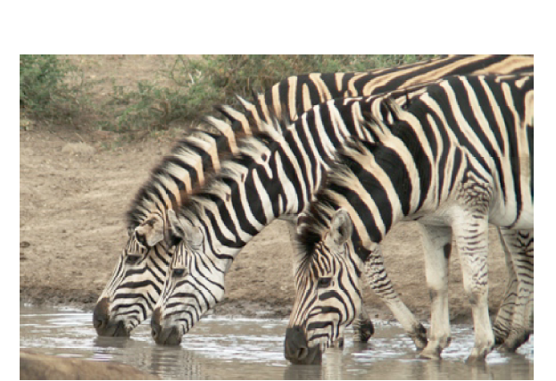
Plasticity: behavioral demonstration in awake behaving animals
Happily Drinking – Safe Sounds

Slide 8
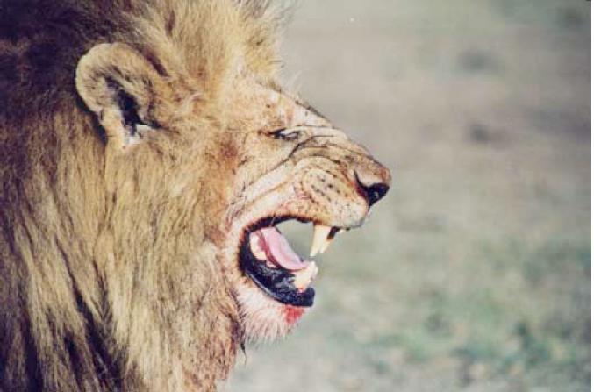

Slide 9
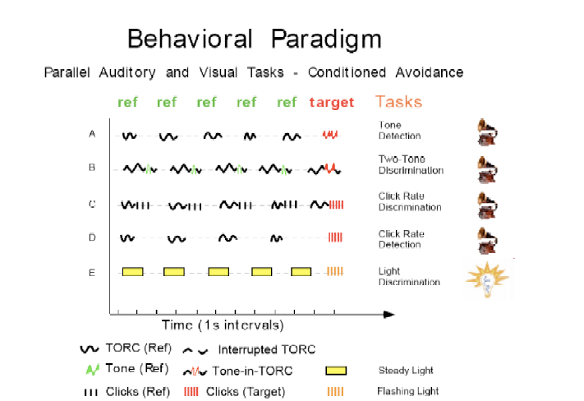
Simple Tasks to Focus Attention on Sound

Slide 10
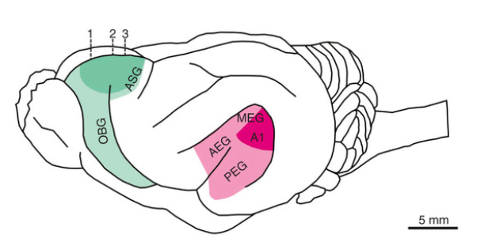
The Adaptive Auditory Brain
Rapid Receptive Field Plasticity in A1

Slide 11
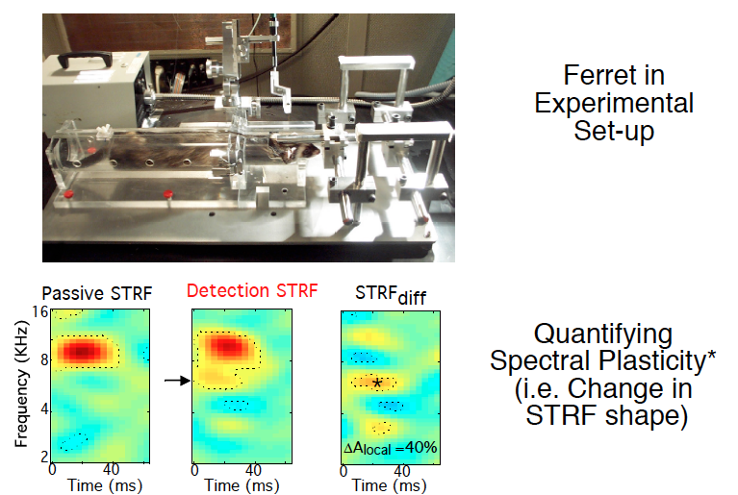

Slide 12

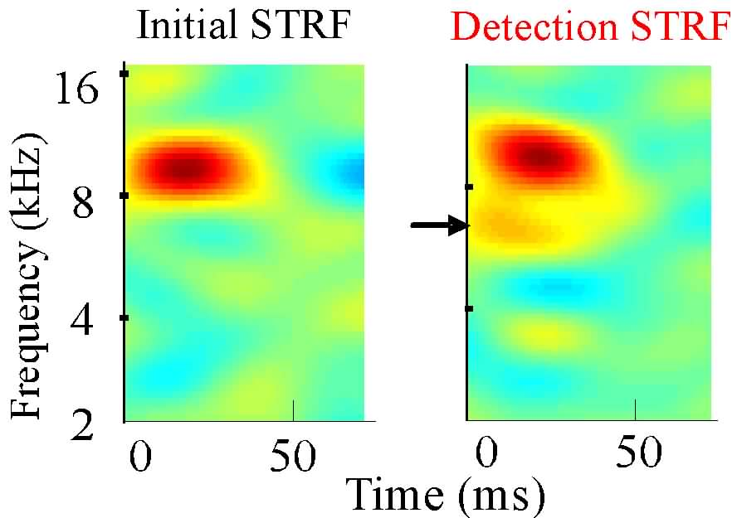
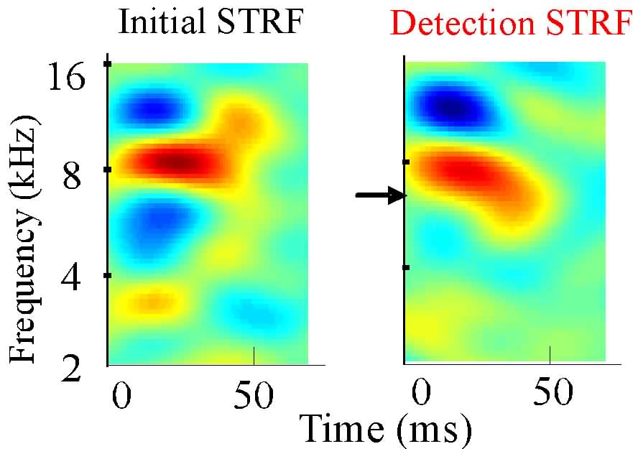
Tone Detection Task
Aversive
Reference
Target
Systematic change at the target frequency across the A1 population
Population
Average
Fritz et al., 2003. Nature Neuroscience

Slide 13
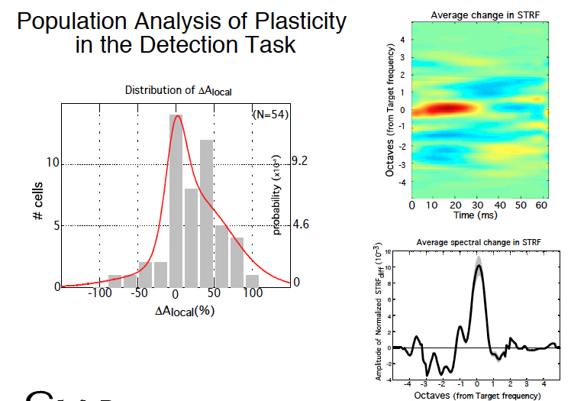
Fritz et al., 2003. Nature Neuroscience

Slide 14
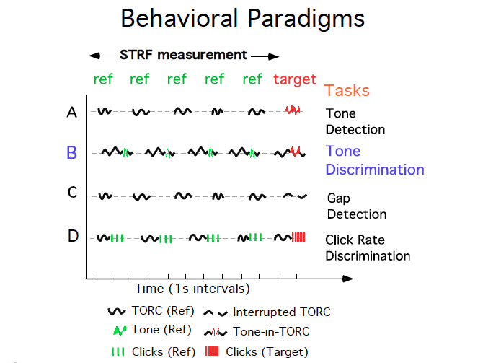

Slide 15
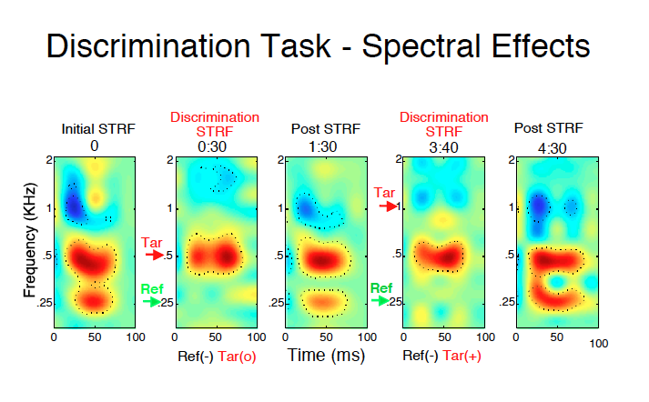
Fritz et al., 2005. JNS

Slide 16
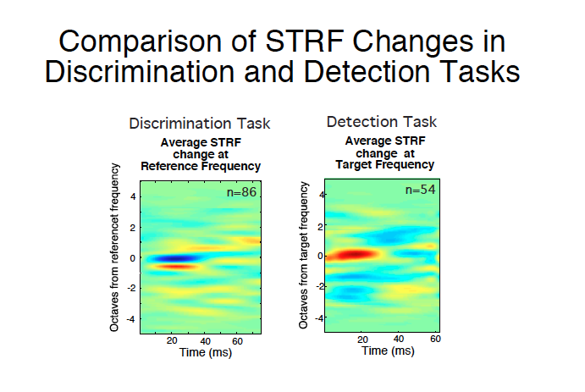
Two-tone
Single-tone
Similar plasticity for a two-tone discrimination task
Contrast enhancement mechanism
Fritz et al., 2005. JNS

Slide 17
Behavioral meaning of 1 kHz tone changed from Ref -> Tar
Similar plasticity for a two-tone discrimination task
Contrast enhancement mechanism
Plasticty change labilly according to task demands
Fritz et al., 2005. JNS

Slide 18
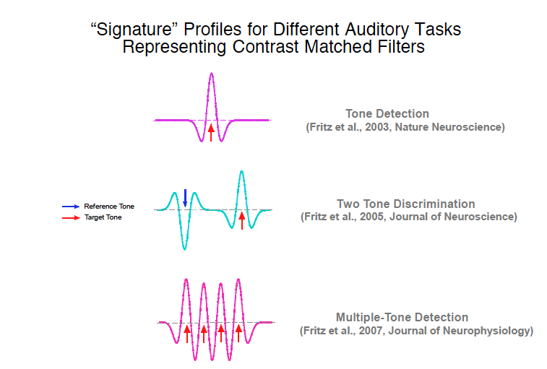
Similar plasticity for a two-tone discrimination task
Contrast enhancement mechanism
Plasticty change labilly according to task demands

Slide 19
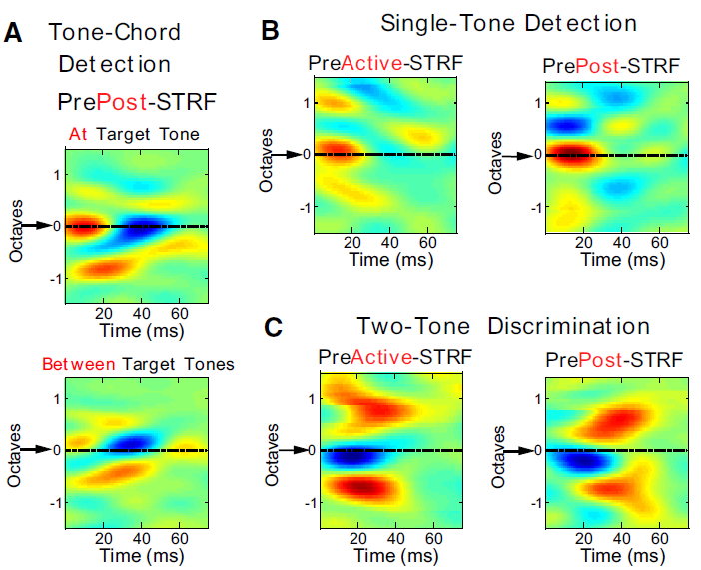
Mid-term changes
Plastic changes last for 1-2 hours
Fritz et al., 2007. JNP

Slide 20
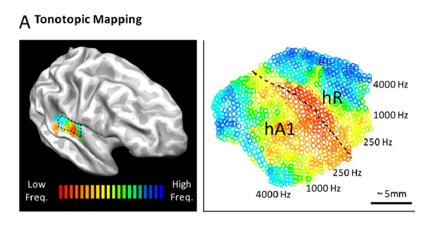
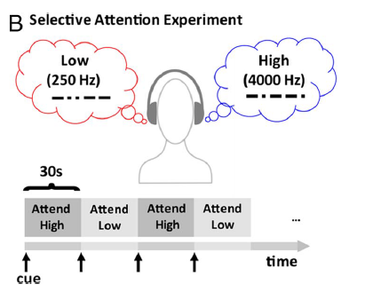
Can such a phenomenon be found in humans?
Fine mapping of primary areas tonotopy, followed by high/low frequency attention
2-stream condition
1 stream in each ear
Da Costa et al., 2013. JNS

Slide 21
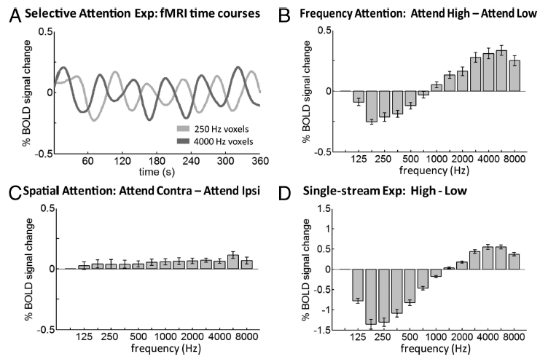
Can such a phenomenon be found in humans?
Fine mapping of primary areas tonotopy, followed by high/low frequency attention
Task-driven enhancement of elicited activity
Da Costa et al., 2013. JNS

Slide 22
Can such a phenomenon be found in humans?
Fine mapping of primary areas tonotopy, followed by high/low frequency attention
Task-driven enhancement of elicited activity
Extend to the spatial domain
Da Costa et al., 2013. JNS

Slide 23
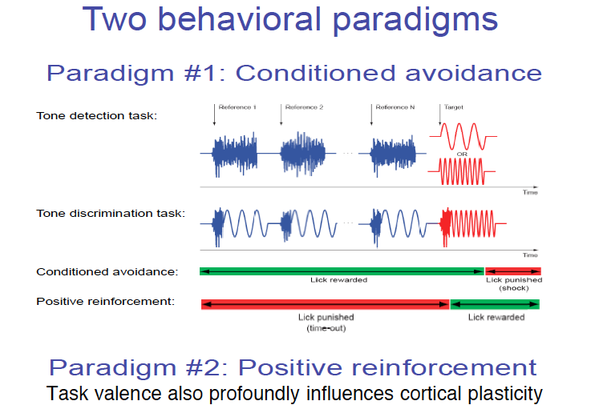
David et al., 2012. PNAS

Slide 24
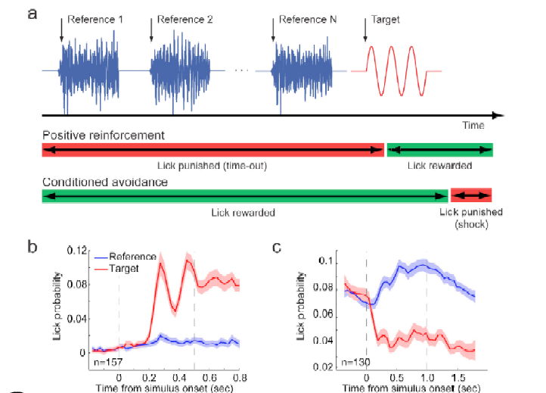
David et al., 2012. PNAS

Slide 25
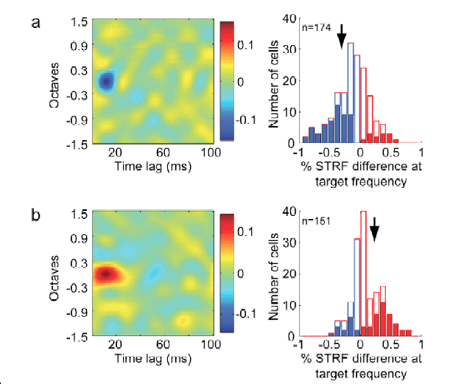
David et al., 2012. PNAS

Slide 26
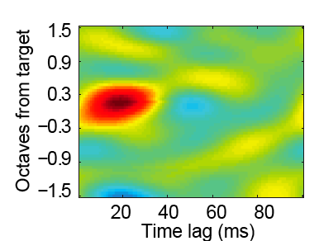
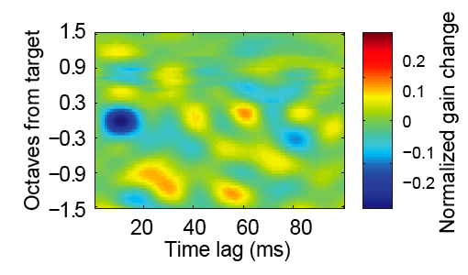
A1 Plasticity in appetitive tasks
Aversive Task
Appetitive Task
Enhancement
Suppression
Similar stimuli, but opposite actions, induce opposite plasticity!
David et al., 2012. PNAS

Slide 27
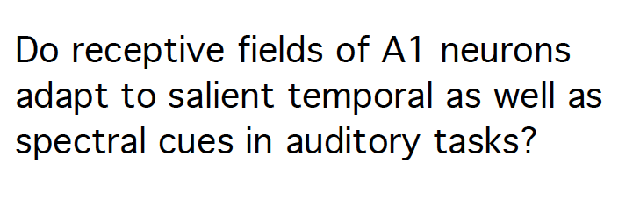

Slide 28

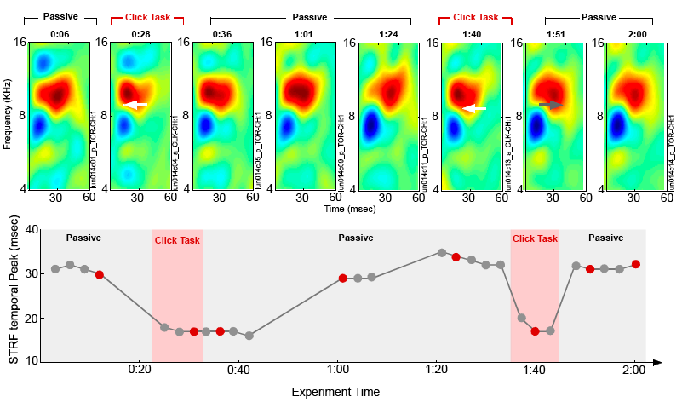
STRF changes in a series of click discrimination tasks

Slide 29
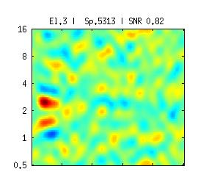
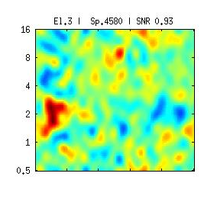
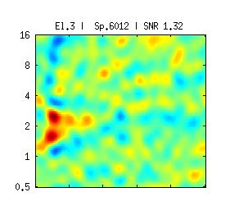
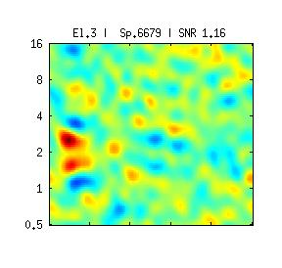
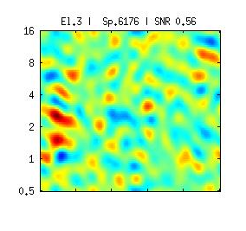
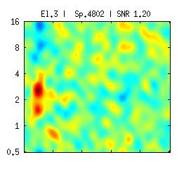
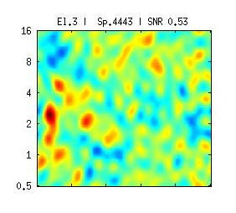
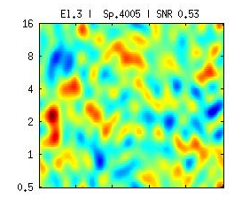
Differential effects in a sequence of spectral and temporal task performance
Spectral Task
Tone Detect
Temporal Task
Click Rate Discrimination
Passive
Active
Passive
Passive

Slide 30
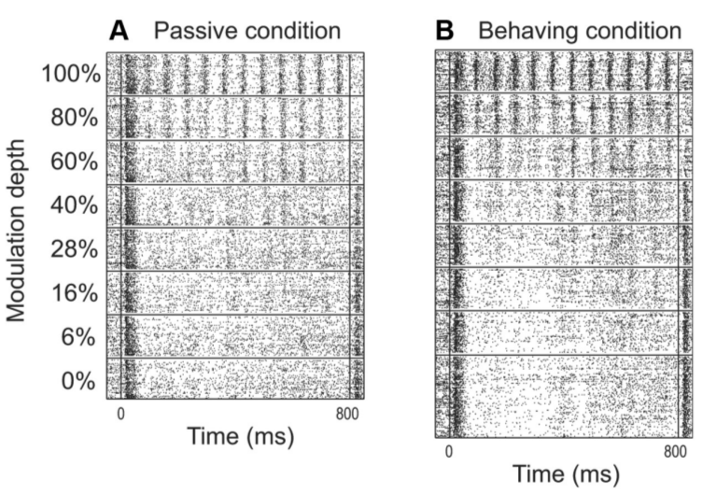
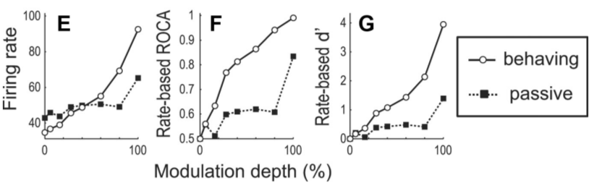
Task-relevant shift in encoding
AM detection (noise) with A1 recordings
Firing rate-based discrimination of stimuli enhanced in active state
Niwa et al, 2012. JNS

Slide 31
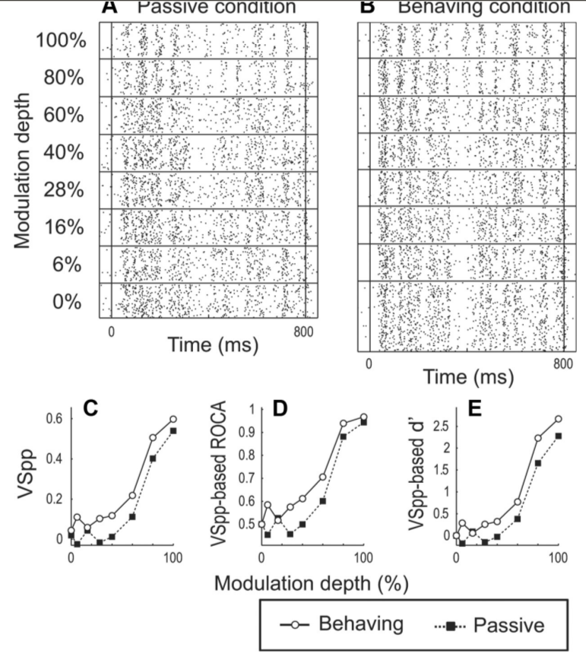
Task-relevant shift in encoding
AM detection (noise) with A1 recordings
Firing rate-based discrimination of stimuli enhanced in active state
Idem for phase-locked response, to a less extent
Niwa et al, 2012. JNS

Slide 32
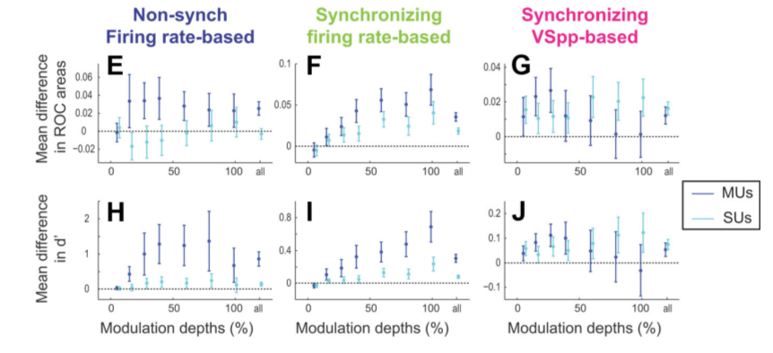
Task-relevant shift in encoding
AM detection (noise) with A1 recordings
Firing rate-based discrimination of stimuli enhanced in active state
Idem for phase-locked response, to a less extent
All types of neurones exhibit an enhancement in firing rate-based codes
Niwa et al, 2012. JNS

Slide 33
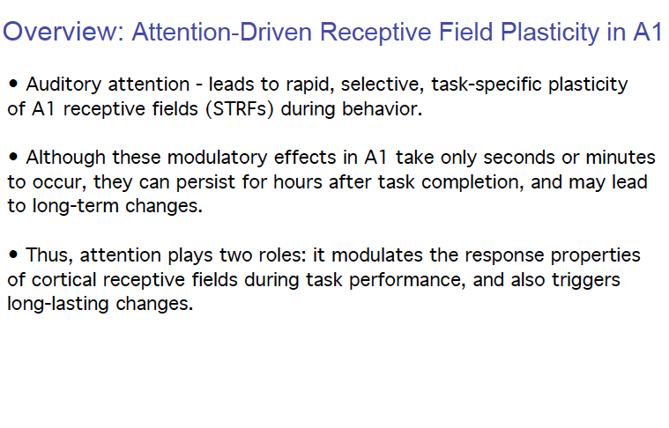
The Adaptive Auditory Brain - A1

Slide 34
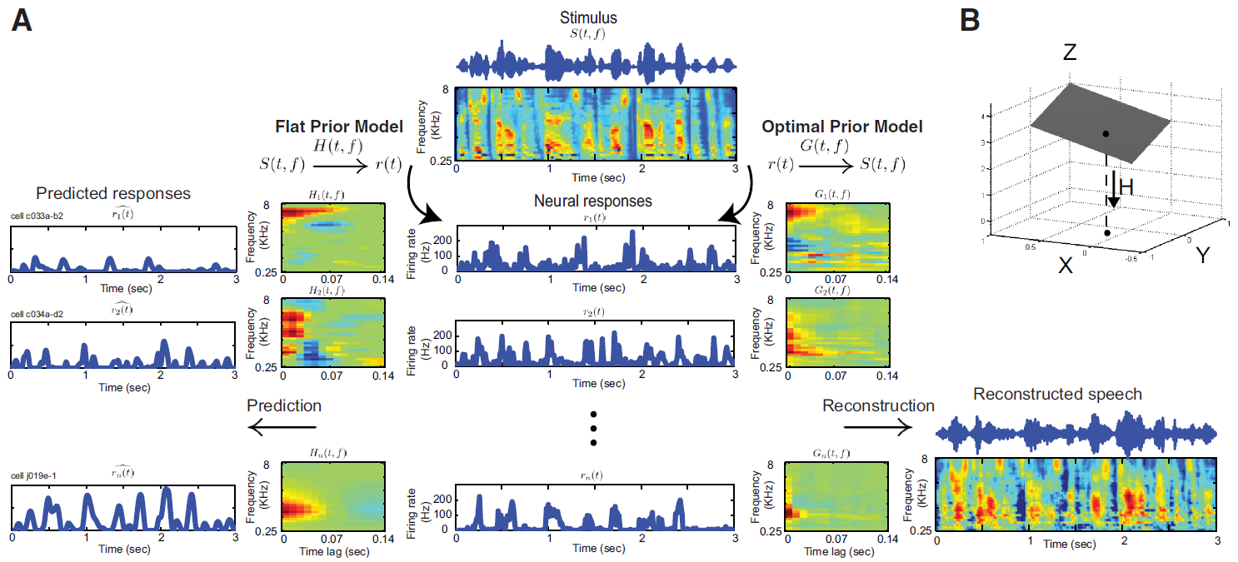
Mapping spectro-temporal receptive fields (STRF)
➔ Mapping spectrogram to neural responses
Mesgarani et al, 2009. J. Neurophysiol.

Slide 35
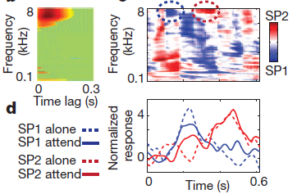
Attention-driven sensory gating:
back to the cocktail party problem
Mixture spectrogram
STRF
Neural delay
Electrode response
Individual electrodes show clear frequency tuning
Effect of attention can be seen at the single electrode level
Mesgarani and Chang, 2012. Nature

Slide 36
Reconstructing stimuli from neural responses
➔ Mapping neural responses to spectrograms
Mesgarani et al, 2009. J. Neurophysiol.

Slide 37
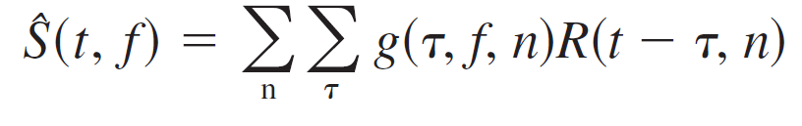
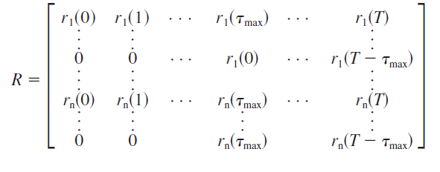
Stimulus reconstruction as linear algebra
Filter
estimation:
Linear algebraic form (using a delay-line, so that all neural responses influencing reconstruction at time t occur in column t of response matrix R):
S = rg
r^{T}S = r^{T}rg
(r^{T}r)⁻¹r^{T}S = g
Estimation:
g = (RR^{T})⁻¹rS^{T}
Optimal reconstruction, because does not whiten the stimulus

Slide 38
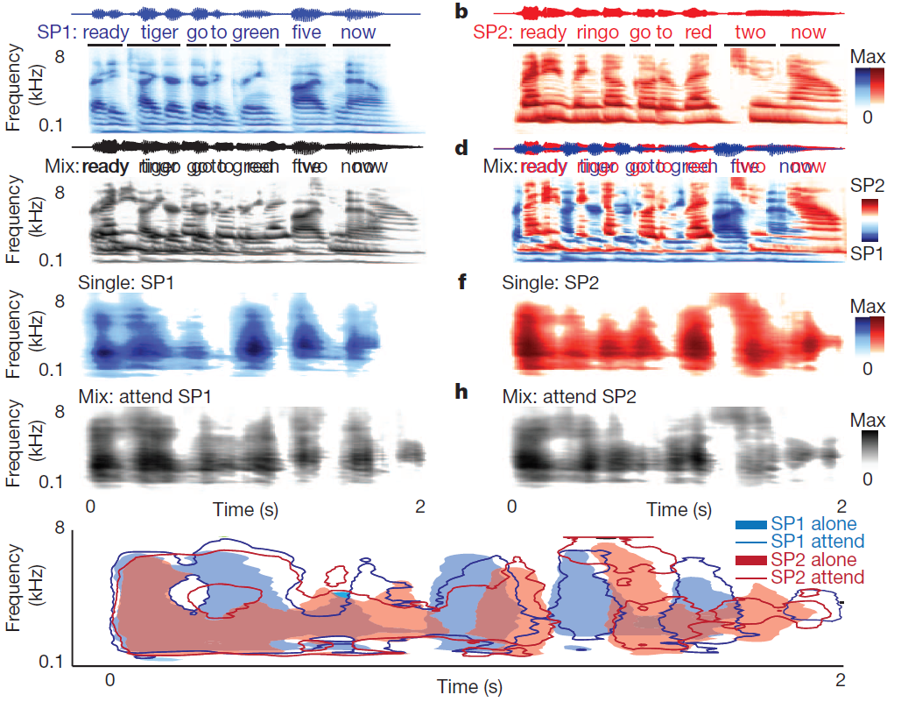
Attention-driven sensory gating:
back to the cocktail party problem
Mesgarani and Chang, 2012. Nature

Slide 39
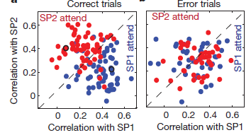
Attention-driven sensory gating:
back to the cocktail party problem
Speech spectrograms reconstructed from cortical responses to the mixture of speakers reveal the attended speaker
Mesgarani and Chang, 2012. Nature

Slide 40

Rapid Receptive Field Plasticity in A1:
investigating single unit activity

Slide 41
Rapid Receptive Field Plasticity in A1:
investigating single unit activity

Slide 42
Attentional Effects and Mixture Segregation in A1

Slide 43
Attentional Effects and Mixture Segregation in A1
Notes:
NOTE: this has not been in EEG, as far as I know…

Slide 44
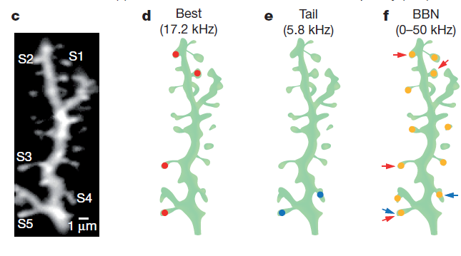
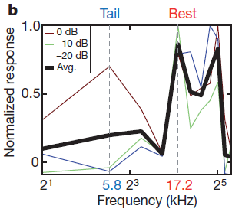
Variability in spine tuning as a substrate for plasticity
Chen et al., 2011. Nature

Slide 45
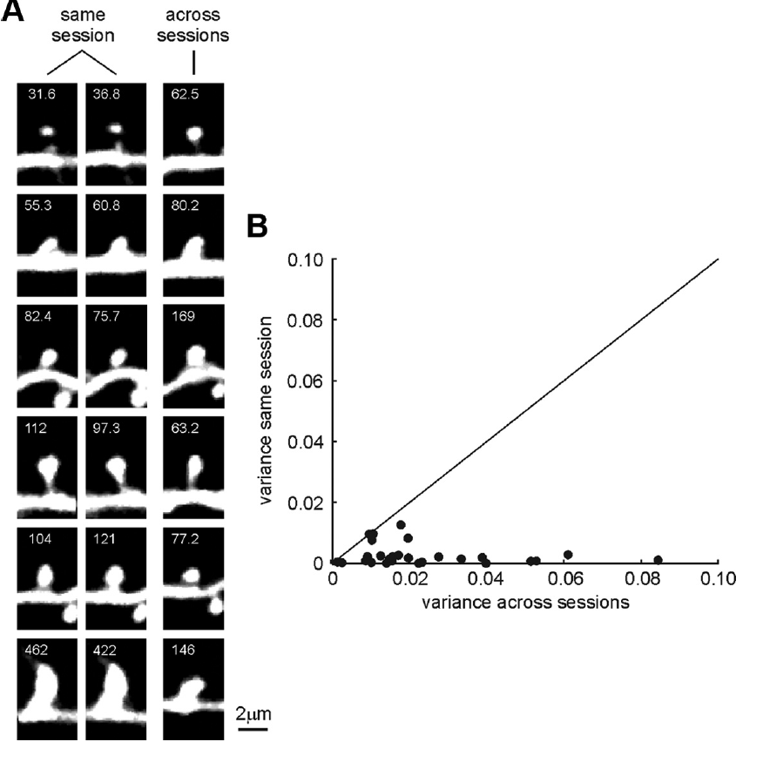
How to concile spine lability
with learning and stable behavior?
Loewenstein et al., 2011. JNS

Slide 46
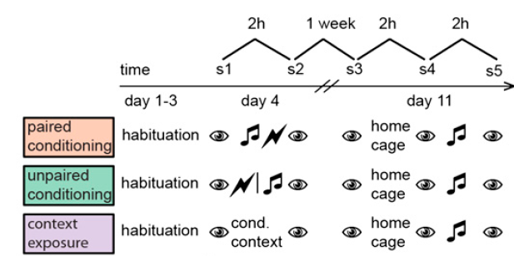
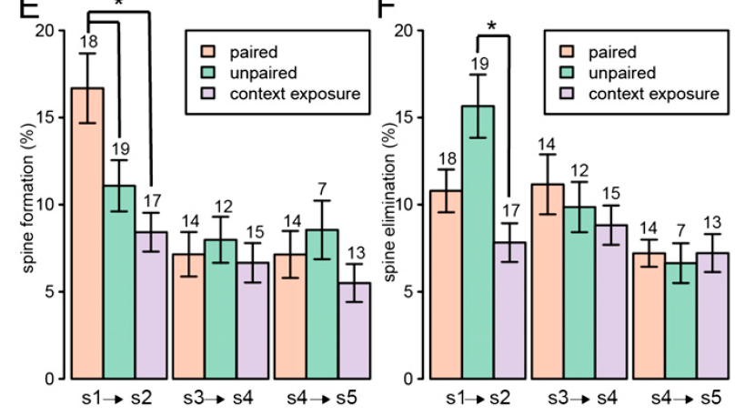
Complex spine dynamics during fear conditioning
Moczulska et al., 2011. PNAS

Slide 47
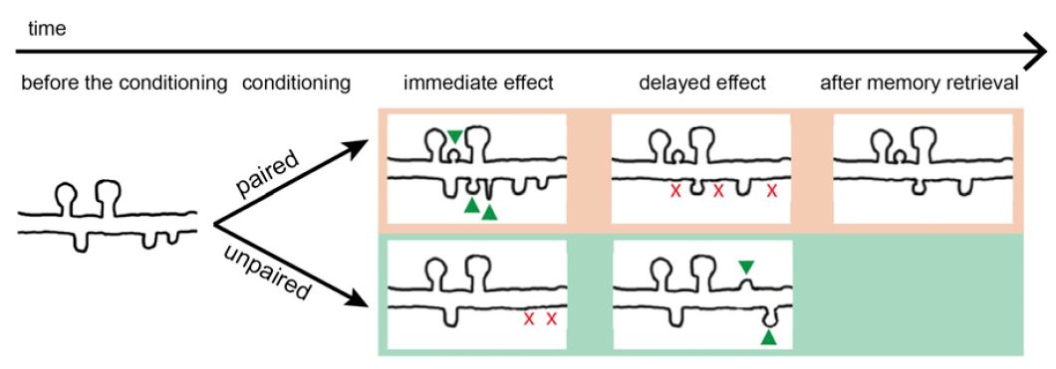
Complex spine dynamics during fear conditioning
Moczulska et al., 2011. PNAS

Slide 48
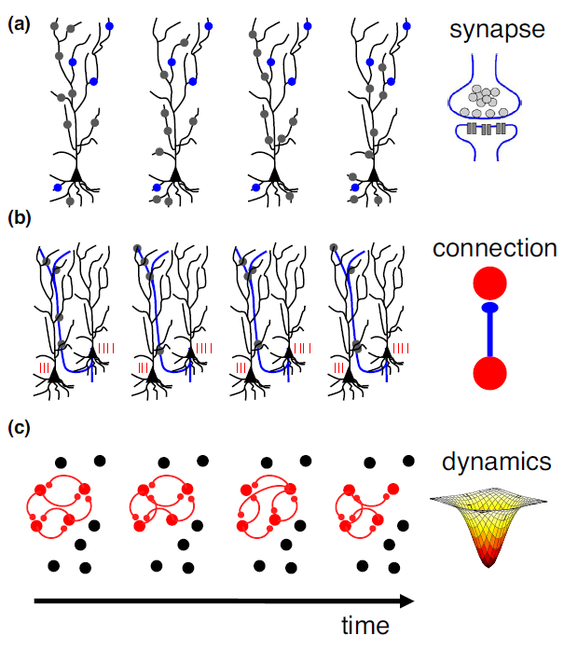
Variability in spine tuning as a substrate for plasticity
Individual spines are unstable while neuronal connectivity pattern is not
Mongillo et al., 2017. Curr. Opinion in Neurobiology

Slide 49
Variability in spine tuning as a substrate for plasticity
Individual spines are unstable while neuronal connectivity pattern is not
Memory stabilization can be achieved by Hebbian-like plasticity that ‘re-learns’ the attractor each time that the memory is reactivated.
Mongillo et al., 2017. Curr. Opinion in Neurobiology

Slide 50
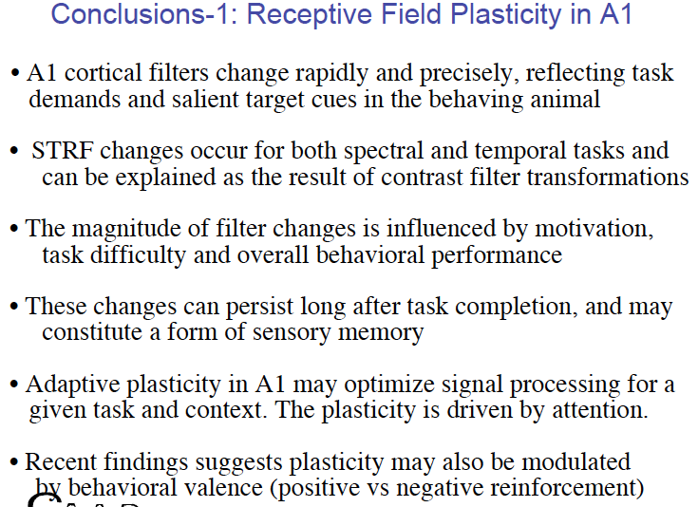

Slide 51









Task-relevant shift in encoding
Task structure and recording
Two ferrets were trained to discriminate two click trains of different frequencies.
Reference
Reference
Target
(…)
GO : Licking for reward
NO
GO
Passive - PRE
Engaged
Passive - POST
Sounds were played during a passive and engaged (behaving) state.
Frequencies were counterbalanced between animals.

Slide 52



Task-relevant shift in encoding
Task structure and recording
Neural activity was recorded from A1 using linear 24-site probe.
N= units.
Construction of Peri Stimulus Time Histograms (PSTH) to evaluate neuronal responses.
Passive
Active
FR - HZ
FR - HZ
Time -s
Time -s

Slide 53

Task-relevant shift in encoding
General response properties
Increase of baseline activity in the engaged state.
No change in click-evoked activity.
Passive
Engaged
FR - HZ
Time -s
MI

Slide 54
Task-relevant shift in encoding
General response properties
Increase of baseline activity in the engaged state.
No change in click-evoked activity.
Decrease of phase-locking to stimulus in the engaged state.
Loss of stimulus synchronized activity.
Reduction in the quality of stimulus representation in the engaged state
ACh is involved in reduction of evoked response during task engagement (not shown here)
Passive
Engaged
FR - HZ
Time -s
MI

Slide 55
Task-relevant shift in encoding
Discrimination between stimuli
To evaluate how the stimulus identity is encoded, neuronal activity is used to decode the stimulus.
Determine axis that best separates two classes after projection : w
Determine threshold that best divides data into two classes after projection : B
Project new point onto w and compare to B.
N2
c₁
w
c₂
N1
B
Classified as class 1
Classified as class 2

Slide 56


Task-relevant shift in encoding
Discrimination between stimuli
Passive pre
Engaged
Passive post
SOUND
accuracy
Decoding during sound presentation is equally accurate in both behavioural states

Slide 57

Decision and memory traces in A1
Signals seems to be organized along the auditory pathway, but we know it is spread.
Bizley et al, 2009. JNS
Notes:
Closing the loop

Slide 58


Decision and memory traces in A1
Signals seems to be organized along the auditory pathway, but we know it is spread.
2AFC task; Ref-Target: is the pitch of the Tar higher or lower than the Ref one.
Choice index quantifies how much the recording site encodes for the behavioural choice or for the physical stimulus F0.
→ Encodes more choice than Fo
Bizley et al, 2013. Current Biology
Notes:
Closing the loop

Slide 59

Decision and memory traces in A1
Passive pre
Engaged
Passive post
SOUND
SILENCE
accuracy
accuracy
Decoding during sound presentation is equally accurate in both behavioural states
Decoding during post-sound silence is enhanced in the engaged state

Slide 60


Where are attentional effects stronger?
Stimulus dependent
Attention related
Attend visual bimodal
-
Attend visual unimodal
Attend auditory bimodal
-
Attend visual bimodal
Detection of repeated stimuli in 1 modality
while uni- or bi-modal stimuli are presented
Petkov et al., 2004. Nature Neuroscience

Slide 61
Where are attentional effects stronger?
Higher-order areas
Stimulus dependent
Attention related
Attention-related modulation seems to be specific to secondary areas.
Attend visual bimodal
-
Attend visual unimodal
Attend auditory bimodal
-
Attend visual bimodal
Petkov et al., 2004. Nature Neuroscience

Slide 62

A1 plasticity and top-down effects
⬅Core – Primary
A1 and AAF
⬅Belt – Secondary
PEG: PPF and PSF
⬅Parabelt – Tertiary
PEG: VPc, VPr, PSSC
Atiani et al, 2014. Neuron

Slide 63

A1 plasticity and top-down effects
Target vs. Ref: Progressive enhanced response to target along the primary areas to frontal path
Passive vs. Active: more and more sensitive effect of task engagement when moving up
Atiani et al, 2014. Neuron

Slide 64

A1 plasticity and top-down effects
Target vs. Ref: Progressive enhanced response to target along the primary areas to frontal path
Passive vs. Active: more and more sensitive effect of task engagement when moving up
Elgueda et al, 2014. ARO Meeting

Slide 65
A1 plasticity and top-down effects
Target vs. Ref: Progressive enhanced response to target along the primary areas to frontal path
Passive vs. Active: more and more sensitive effect of task engagement when moving up
Cell response to behavioral meaning instead of acoustic features
Sec. aCx
GO
Categorical responses
NO GO
Elgueda et al, 2014. ARO Meeting

Slide 66

Multi-feature encoding in PFC
PFC cells are midway to motor output
See Cours CA4(b) : Neurophysiologie cognitive de la perception
http://www.cognition.ens.fr/CA4b.html

Slide 67

Multi-feature encoding in PFC
Sensory
Motor
Sensory
PFC cells are midway to motor output
PFC responses are also multimodal with cells responding to acoustic and light targets
See Cours NP1 : Neurophysiologie cognitive de la perception
http://www.cognition.ens.fr/NP1.html

Slide 68

A1 plasticity and top-down effects
Simultaneous LFP recordings in A1/dlFC
Gating of information in dlPFC in active state (Ref. response act. vs passive)
Loss of coherence in the beta-band during the active state and the first trials of the post-passive → correlate for plasticity?
This decrease in coherence is more clear in the target area of A1.
Fritz et al, 2010. Nature Neuro

Slide 69

STRF Changes Induced by OFC Stimulation
Ferret brain
Pairing of the OFC in mice decreases synchronization at the PF
Winkowski et al, 2013. JNS

Slide 70



STRF Changes Induced by OFC Stimulation
2P imaging
Ferret brain
Pairing of the OFC in mice decreases synchronization at the PF
Mean effect of excitation @ PF=BF
Not mediated by ACh?
Random PF
Sound Alone
Pairing
Winkowski et al, 2013. JNS

Slide 71
Conclusions: target-extraction during task engagement
Emergence of a task-dependant and task-relevant neuronal response along the auditory pathway up to the prefrontal cortex (PFC)
PFC shows supramodal representation of the asbtract category
PFC and A1 synchronization is modulated during behavior, in a task-relevant maneer (top-down?)

Slide 72


Emergence of task-related activity along the auditory cortical pathway
Atiani et al, 2014
Notes:
This comes with decrease or a gating of the reference-elicited response in these different areas, as you can see on the bottom panels here.

Slide 73
Emergence of task-related activity along the auditory cortical pathway
Atiani et al, 2014
Notes:
Focusing on A1, one can see there is only a slight task-related modulation of the target- and reference-elicited activity in A1 during task engagement. However we know from the works of others that traces of decision can be found in A1, at least in the ferret. Take for example the work of Jennifer Bizley from UCL. In the following of my talk, I will develop how more subtle analysis than PSTHs can unreveal an encoding of stimulus behavioral meaning in A1, at the population level.

Slide 74



Change in response properties with task engagement: average firing rate
N=370
Notes:
First I’d like to briefly comment on firing rates when averaging the activity of the recorded population in A1 in this task.
In this PSTH we can see the average activity of a large population of neurons throughout the trial in the active and passive states.

Slide 75

How does discrimination of stimulus identity change?
→ How does task engagement affect stimulus identity discrimination in primary auditory cortex?
→ train a binary linear classifier on the neuronal population activity
N1
N2
Notes:
To address this point we trained a binary linear classifier to discriminate between reference and target stimuli, based on the neuronal firing rate recorded in these 2 types of trials.
Here I illustrate the principle with the firing rate of 2 neurons on these 2 axis, but we actually use a few 100s of cells.
This provides us with a classification axis, w, which reduces our high-dimensional data set to a single task-relevant dimension since this axis optimizes the distance between the two types of trials the animals had to discriminate.
Importantly, this decoding vector is computed at each point in time.

Slide 76

How does discrimination of stimulus identity change?
→ How does task engagement affect stimulus identity discrimination in primary auditory cortex?
→ train a binary linear classifier on the neuronal population activity → perceptron-like approach
→ train a binary linear classifier on the neuronal population activity
N1
N1
(t)
(t)
(t)
(t)
N2
N2
Notes:
You can also see this decoder as a perceptron fed with the activity of the different neurons,

Slide 77
How does discrimination of stimulus identity change?
→ How does task engagement affect stimulus identity discrimination in primary auditory cortex?
→ train a binary linear classifier on the neuronal population activity → perceptron-like approach
→ train a binary linear classifier on the neuronal population activity
N1
(t)
>B: reference
(t)
(t)
(t)
<B: target
N2
Notes:
each neuron being assigned a weight w which can be seen as the synaptic weight of this input neuron for the readout neurone.
The output of this linear readout will classify a given trial as reference or target, depending on a given threshold.

Slide 78

How does discrimination of stimulus identity change?
Decoder
accuracy
Information about the stimulus identity is:
preserved during task engagement
Notes:
We evaluated the classifier accuracy, here on the y axis, by cross-validation.
During the silence and the initial neutral noise burst, chance performance, SANITY CHECK.
We found high and equivalent accuracy in the passive and active states during sound presentation.

Slide 79
How does discrimination of stimulus identity change?
Decoder
accuracy
Information about the stimulus identity is:
preserved during task engagement
sustained after stimulus presentation during behavior
Notes:
However during the silence accuracy quickly decayed in the passive state but in the active state remained high throughout the silence.
Therefore task engagement enhances the memory of the class of the previous stimuli.
Since it is known that the motor cortex projects to A1, one could object that this enhanced representation of stimulus identity in the active state is ascribed to motor-elicited activity in A1.

Slide 80


How does discrimination of stimulus identity change?
(miss)
Information about the stimulus identity is:
preserved during task engagement
sustained after stimulus presentation during behavior
independent from licking activity
correlated with behavioral outcome
→ Top-down modulation of A1 population activity?
Notes:
We observed that on error trials, when the animal licked during the no-go period, the stimulus memory was impaired.
This demonstrates a clear correlation between the behavioral performance and the information about the stimulus behavioral meaning present during the delay period in A1, in favor of a behavior-dependent persistent categorical stimulus encoding in A1.
In a second part of the talk,…

Slide 81

How do references and targets contribute to the encoding of stimulus category?
→Project target-/reference- elicited activity onto the decoding vector
Decoder-
projected value
0=projected baseline act.
Time (s)
Notes:
1)) We used the average decoding vectors from the sound period to compute these projections, in the GRAY shaded area.
2)) Projected data were baseline-corrected, so 0 is the projected value for the spontaneous firing rate.
First, when the stimulus appears projections from reference-elicited and target-elicited neuronal activity diverge each other, which is expected as the distance between the two enables us to classify them.

Slide 82
How do references and targets contribute to the encoding of stimulus category?
→Project target-/reference- elicited activity onto the decoding vector
Decoder-
projected value
Decoder-
projected value
0=projected baseline act.
0=projected baseline act.
Time (s)
Notes:
In contrast, in the active state we can see that throughout the trial, the target stimulus is playing the dominant role in classification ability.
Of course A1 neurons respond at both stimuli but we wanted to see whether the two stimuli were playing equivalent roles in encoding.

Slide 83
Target-driven encoding of sound identity in active state in A1
Decoder-
projected value
Decoder-
projected value
0=projected baseline act.
0=projected baseline act.
Time (s)
Time (s)
→Passive: symmetrical roles of ref. and targets
→Active: asymmetrical encoding of behavioral meaning
Notes:
Therefore in the active state the neuronal population displays a asymmetrical encoding of behavioral meaning.
SHIFT of stimuli encoding, from equivalent roles to target-driven, or even ACTION-DRIVEN.

Slide 84


Target-driven encoding of sound identity in active state in A1
Decoder-
projected value
Decoder-
projected value
0=projected baseline act.
0=projected baseline act.
Time (s)
Time (s)
→Passive: symmetrical roles of ref. and targets
→Active: asymmetrical encoding of behavioral meaning
Notes:
And this is quantified in the bottom plots, where you can observe the ABSOLUTE value of the projected response for the reference and target trials, with the same color.
While there is not significant difference between the 2 stimuli in the passive state, you observe a significant difference between the 2 stimuli in the active state, confirming this asymetrical representation of stimuli in the active state.

Slide 85
Target-driven encoding of sound identity in active state in A1
Decoder-
projected value
Decoder-
projected value
0=projected baseline act.
0=projected baseline act.
Time (s)
Time (s)
→Passive: symmetrical roles of ref. and targets
→Active: asymmetrical encoding of behavioral meaning
→Mechanism present:
across tasks (relative pitch discrimination, tone detection…)
across reinforcement types (appetitive vs. aversive)
Notes:
What is fascinating is that we reached exactly the same conclusion about a target-driven stimulus representation in A1 a variety of other tasks and also in a paradigm using positive reinforcement, indicating that this persistent target-driven encoding in A1 can be a general feature of discrimination tasks.

Slide 86

Frontal cortex responses mirror
A1-projected data
z-score
Decoder-
projected value
Time (s)
Time (s)
FC
Firing rate
A1
Projection onto decoder
→Does primary auditory cortex preshape behaviorally-relevant information at the population level to be easily readout by higher-order areas?
They both exhibit a target-driven encoding
(A1: population level / FC: single cell level)
They both show sustained target-specific response
Notes:
Simply because recordings performed in frontal cortex (FC) during the click rate discrimination task showed that, when the animal is engaged in the task, FC single units also encode the abstract behavioral meaning of the stimuli. By comparing these 2 graphs, one can see common features between FC and projections of A1 population activity:

Slide 87
Conclusions: A1 population activity show task-dependent stimulus representation
A1 population activity can reflect the behavioral choice of the animal
A1 population activity can encode the abstract meaning of stimuli
A linear readout mechanism can recover a PFC-like response pattern

Slide 88

Acetylcholine and plasticity…

Slide 89

Initial demonstration of ACh-mediated plasticity in A1
Classical conditionning with Conditionned Stimulus (tone) and Unconditionned Stimulus (shock) that elicits a Conditionned Response (behavior) after a few trials (20-30 trials)
BF in A1 can change after pairing
PF
BF
PF
(BF)
Bakin and Weinberger, 1990. Brain Res.

Slide 90



Initial demonstration of ACh-mediated plasticity in A1
Classical conditionning with Conditionned Stimulus (tone) and Unconditionned Stimulus (shock) that elicits a Conditionned Response (behavior) after a few trials (20-30 trials)
BF in A1 can change after pairing
Plasticity can last at least up to 24 hours
Sensitization (unpaired stim/shock) does not elicit any plasticity (but a general increase)
Bakin and Weinberger, 1990. Brain Res.

Slide 91


Long-lasting plasticity is specific of cortex
MGBv shows instantaneous plasticity, but this vanishes after a few tens of minutes
Cell 1
Cell 2
Edeline and Weinberger, 1991. Beha. Neuro.

Slide 92

Long-lasting plasticity is specific of cortex
MGBv shows instantaneous plasticity, but this vanishes after a few tens of minutes
MGBm shows longer lasting effects (see later, possible role in plastivity)
Edeline and Weinberger, 1992. Beha. Neuro.

Slide 93

Involvement of ACh in plasticity in frequency tuning
Remapping of A1 can be induced by massive electrical stimulation of the basal forebrain (which contains Nucleus Basalis)
Kilgard and Merzenich, 1998. Science.

Slide 94



Involvement of ACh in plasticity in frequency tuning
Remapping of A1 can be induced by massive electrical stimulation of the basal forebrain (which contains Nucleus Basalis)
Coincidence between tone and ACh release
Kilgard and Merzenich, 1998. Science.

Slide 95



Involvement of ACh in plasticity in frequency tuning
Remapping of A1 can be induced by massive electrical stimulation of the basal forebrain (which contains Nucleus Basalis)
Coincidence between tone and ACh release
Plasticity extends to fine features of cell tuning (mirrors results obtained under training)
Thick = paired
Dashed = non-paired (identical nb of presentations)
Kilgard and Merzenich, 1998. Science.

Slide 96


Plasticity of temporal tuning in A1
Same protocol than previous slide with click trains of different rates
Plasticity extends to the temporal domain
Kilgard and Merzenich, 1998. Nature.

Slide 97


Order-sensitive plasticity in A1
Strict order-sensitive response for 3rd token in (A)
or looser specificity in (B): clear enhancement to 2nd (>50%) and 3rd (25%) tokens when preceded
Kilgard and Merzenich, 2002. PNAS.

Slide 98

Order-sensitive plasticity in A1
Strict order-sensitive response for 3rd token in (A)
or looser specificity in (B): clear enhancement to 2nd (>50%) and 3rd (25%) tokens when preceded
No change in neuronal tuning, but decrease in latency and in jitter.
Kilgard and Merzenich, 2002. PNAS.

Slide 99

Time course of acetylcholine-induced plasticity
Froemke et al., 2002. Nature

Slide 100

Time course of acetylcholine-induced plasticity
Hebbian synaptic plasticity induced by tone-NB stimulation
Froemke et al., 2002. Nature

Slide 101

Time course of acetylcholine-induced plasticity
Hebbian synaptic plasticity induced by tone-NB stimulation
Froemke et al., 2002. Nature

Slide 102


Time course of acetylcholine-induced plasticity
ionotropic
metabotropic
atropine = antagonist ACh over metabotropic ACh receptors, namely muscarinic receptors
≠ nicotinic (ionotropic) receptors (agonist is … nicotine)
Froemke et al., 2002. Nature

Slide 103
Time course of acetylcholine-induced plasticity
decoupling between excitation and inhibition:
→ dysinhibition occurs first (~20s), followed by increase in excitability (~60s).
Froemke et al., 2002. Nature

Slide 104

Time course of acetylcholine-induced plasticity
Long-term synaptic modifications are consistent with classical conditionning experiments
Plasticity-induced unbalance in EI ratio is maintained in quiet environment
@ PF
@ PF
Froemke et al., 2007. Nature
Under tonal stimulation

Slide 105


Intracortical location of acetylcholine-induced plasticity
ACh-induced plasticity takes place at synapses between excitatory and inhibitory A1 cells
cx
thalamus
Froemke et al., 2007. Nature

Slide 106

Homeostasis of cortical plasticity
ACh-induced plasticity takes place at synapses between excitatory and inhibitory A1 cells
Plasticity-induced excitation is counterbalanced by increased inhibition
Froemke et al., 2013. Nat. Neuro

Slide 107

Homeostasis of cortical plasticity
ACh-induced plasticity takes place at synapses between excitatory and inhibitory A1 cells
Plasticity-induced excitation is counterbalanced by increased inhibition
Froemke et al., 2013. Nat. Neuro

Slide 108

Homeostasis of cortical plasticity and recent past history
ACh-induced plasticity takes place at synapses between excitatory and inhibitory A1 cells
Plasticity-induced excitation is counterbalanced by increased inhibition
Froemke et al., 2013. Nat. Neuro

Slide 109

Homeostasis of cortical plasticity and recent past history
ACh-induced plasticity takes place at synapses between excitatory and inhibitory A1 cells
Plasticity-induced excitation is counterbalanced by increased inhibition
Plasticity incorporates recent stimulus history
Froemke et al., 2013. Nat. Neuro

Slide 110

Prominent role of muscarinic receptors in plasticity
Muscarinic R:
L3/4: enhancement of post-synaptic excitability [plasticity]
Nicotinic R:
→TC synapses: enhance transmission [plasticity]
Metherate et al., 2011. Neuro. and Biobehavioral reviews

Slide 111
Conclusions: acetylcholine release induces plasticity in A1
Ach-induced plasticity are not restricted to the frequency domain, but also extends to the modulation rate, sequence order…
This plasticity takes place at the level of the cortico-cortical synapses, involving muscarinic receptors, and prominently engages intracortical inhibition.

Slide 112

NB-induced plasticity is reflected in behavioral performance
Tone detection task
Wideband noise: animal is at saturation
Narrowband noise: clear improvement after tone-paired NB stimulation
Example animal
Froemke et al., 2013. Nat. Neuro

Slide 113

NB-induced plasticity is reflected in behavioral performance
Tone detection task
Wideband noise: animal is at saturation
Narrowband noise: clear improvement after tone-paired NB stimulation
Example animal
Froemke et al., 2013. Nat. Neuro

Slide 114


NB is required for normal task performance
Ferrets had to orient to the stimulus location / NB lesions
Leach et al., 2013. JNS

Slide 115

NB is required for normal task performance
Ferrets had to orient to the stimulus location / NB lesions
Performance is impaired for short stimulus durations / RT are longer for long durations
→ attention or memory of the target spout?
Leach et al., 2013. JNS

Slide 116

NB is required for behavioral plasticity
Ferrets had to orient to the stimulus location / NB lesions
Performance is impaired for short stimulus durations / RT are longer for long durations
→ attention or memory of the target spout?
NB is required for shifting sensory cue (interaural cue [ITD/ILD] →spectral cue)
Leach et al., 2013. JNS

Slide 117

Reward-associated plasiticity and operant conditionning
Mice had to find the bull’s eye location, with 20dB or 70dB noise amplitude
Polley et al., 2004. PNAS

Slide 118

Reward-associated plasiticity and operant conditionning
Mice had to find the bull’s eye location, with 20dB or 70dB noise amplitude
NC: control
USR: unconditionned
PSR: conditionned
IC: instrumental condtionning
Polley et al., 2004. PNAS

Slide 119

Reward-associated plasiticity and operant conditionning
Mice had to find the bull’s eye location, with 20dB or 70dB noise amplitude
NC: control
USR: unconditionned
PSR: conditionned
IC: instrumental condtionning
Both PSR and IC induce a shift of the response function to a non-linear shape
Polley et al., 2004. PNAS

Slide 120
Reward-associated plasiticity and operant conditionning
Mice had to find the bull’s eye location, with 20dB or 70dB noise amplitude
NC: control
USR: unconditionned
PSR: conditionned
IC: instrumental condtionning
Both PSR and IC induce a shift of the response function to a non-linear shape
→ How to specifically look at top-down effects?
Polley et al., 2004. PNAS

Slide 121

Behavioral training reshapes
A1 organization
Training on a frequency detection task specifically elicits an expansion in the tonopic map at the target frequency, even if there is some dependence target frequency-sound level
Pooley et al., 2006. JNS

Slide 122

Behavioral training reshapes
A1 organization
Training on a frequency detection task specifically elicits an expansion in the tonopic map at the target frequency, even if there is some dependence target frequency-sound level
This is also true when looking at the loudness map
Pooley et al., 2006. JNS

Slide 123


Behavioral training reshapes
A1 organization temporarily
Map expansion is only temporary as tonotopic maps renormalizes after time
Reed et al., 2011. Neuron

Slide 124
Conclusions: training reshapes auditory cortex organization
ACh improves perceptual learning
ACh (or at least the Nucleus Basalis) is necessary for learning
Pairing with a reward can elicits the same effect than observed during instrumental (=operant) conditionning
Changes in the map are short-termed
Top-down effects control task-relevant plasticity in carefully designed protocols

Slide 125


ACh release to mPFC is required for cue detection
mPFC in rodents = dlPFC in larger mammals
mice had to detect cue and get a reward with random ITI. Cue indicate to stop task-irrelevant activity.
Hangya et al., 2015. Cell
Parikh et al., 2007. Neuron

Slide 126


ACh release to mPFC is required for cue detection
mPFC in rodents = dlPFC in larger mammals
mice had to detect cue and get a reward with random ITI. Cue indicate to stop task-irrelevant activity.
cue-evoked ACh release in mPFC
Not present in missed, even if reward is delivered and caught
➔ Not reward prediction
Parikh et al., 2007. Neuron

Slide 127

ACh release to mPFC is required for cue detection
mPFC in rodents = dlPFC in larger mammals
mice had to detect cue and get a reward with random ITI. Cue indicate to stop task-irrelevant activity.
Learning-dependent cue-evoked ACh release in mPFC
Not present in missed, even if reward is delivered and caught
➔ Not reward prediction
Parikh et al., 2007. Neuron

Slide 128

ACh release to mPFC is required for cue detection
mPFC in rodents = dlPFC in larger mammals
mice had to detect cue and get a reward with random ITI. Cue indicate to stop task-irrelevant activity.
Learning-dependent cue-evoked ACh release in mPFC
Not present in missed, even if reward is delivered and caught
➔ Not reward prediction
Also present in catch trials
Parikh et al., 2007. Neuron

Slide 129

ACh release to mPFC is required for cue detection
mPFC in rodents = dlPFC in larger mammals
mice had to detect cue and get a reward with random ITI. Cue indicate to stop task-irrelevant activity.
Learning-dependent cue-evoked ACh release in mPFC
Not present in missed, even if reward is delivered and caught
➔ Not reward prediction
Also present in catch trials
Timing of the transient changes with reward delay
➔ Not sensory processing
reward delay
Parikh et al., 2007. Neuron

Slide 130

ACh release to mPFC is required for cue detection
mPFC in rodents = dlPFC in larger mammals
mice had to detect cue and get a reward with random ITI. Cue indicate to stop task-irrelevant activity.
Learning-dependent cue-evoked ACh release in mPFC
Not present in missed, even if reward is delivered and caught
➔ Not reward prediction
Also present in catch trials
Timing of the transient changes with reward delay
➔ Not sensory processing
ACh fibers in mPFC are necessary for the task, but not those in M1
➔ ACh signals a cognitive operation
Parikh et al., 2007. Neuron

Slide 131
ACh release to mPFC is required for cue detection
mPFC in rodents = dlPFC in larger mammals
mice had to detect cue and get a reward with random ITI. Cue indicate to stop task-irrelevant activity.
Learning-dependent cue-evoked ACh release in mPFC
Not present in missed, even if reward is delivered and caught
➔ Not reward prediction
Also present in catch trials
Timing of the transient changes with reward delay
➔ Not sensory processing
ACh fibers in mPFC are necessary for the task, but not those in M1
➔ ACh signals a cognitive operation attentional shift to the mPFC
Parikh et al., 2007. Neuron
Notes:
Remember Dias and co.
BUT NORADRENERGIC, BUT NOT CHOLINERGIC, DEAFFERENTATION OF
PREFRONTAL CORTEX IMPAIRS ATTENTIONAL SET-SHIFTING
J. McGAUGHY, R. S. ROSS AND H. EICHENBAUM
Claims that Nad signal sto mPFC is necessary for the Dias’ task, ad NOT AT ALL Ach…
Enhanced Control of Attention by Stimulating Mesolimbic–Corticopetal Cholinergic Circuitry
Megan St. Peters
NAccumbens projects onto NB and controls it

Slide 132


Attention-specific deficit induced by BF lesions
BF-lesioned monkeys were tested with a large variety of tasks:
-- DNMS~STM
-- Discrimination Reversal~LTM
→no effect
Only an « attentional » task showed a dependence on the BF cholinergic system
Voytko et al., 1994. Neuron

Slide 133


Attention-specific deficit induced by BF lesions
Learn everyday the « right » letters
BF-lesioned monkeys were tested with a large variety of tasks:
-- DNMS~STM
-- Discrimination Reversal~LTM
→no effect
Only an « attentional » task showed a dependence on the BF cholinergic system
Either episodic memory or strategy implementation tasks were not impaired by destruction of BF neurons projecting to PFC
Find the « right » sequence
Croxson et al, 2011. Nat Neuro

Slide 134


Attention-specific deficit induced by BF lesions
BF-lesioned monkeys were tested with a large variety of tasks:
-- DNMS~STM
-- Discrimination Reversal~LTM
→no effect
Only an « attentional » task showed a dependence on the BF cholinergic system
Either episodic memory or strategy implementation tasks were not impaired by destruction of BF neurons projecting to PFC
BUT working memory task was affected
Croxson et al, 2011. Nat Neuro
Notes:
Match with:
Cholinergic Enhancement and Increased Selectivity of Perceptual Processing During Working Memory
Maura L. Furey, Pietro Pietrini, James V. Haxby

Slide 135


ACh and attention level
Detection of signal (light) or no-signal trials with random ITI
mPFC ACh level increases as the task starts
Kozak et al, 2006. JNS

Slide 136


ACh and attention level
Detection of signal (light) or no-signal trials with random ITI
mPFC ACh level increases as the task starts
Performance is degraded by NMDA antagonist in BF (=APV)
ACh correlates with attentional load, but not with performance
Kozak et al, 2006. JNS

Slide 137

ACh, FC, and distractor effects
Detection of signal (light) or no-signal trials with random ITI
Cholinergic afferent to mPFC lesioned
Distractor effect on lesioned rats
➔Filtering of distractor in PC and aCx
Newman et al, 2008. JNS

Slide 138


ACh, FC, and distractor effects
Detection of signal (light) or no-signal trials with random ITI
Cholinergic afferent to mPFC lesioned
Distractor effect on lesioned rats
A regular distractor enhances performance of lesioned rats (regular timing for attending)
➔Filtering of distractor in PC and aCx
Newman et al, 2008. JNS

Slide 139

ACh, FC, and distractor effects
Detection of signal (light) or no-signal trials with random ITI
Cholinergic afferent to mPFC lesioned
Distractor effect on lesioned rats
A regular distractor enhances performance of lesioned rats (regular timing for attending)
More sensitive to increase in the uncertainty of ITI
➔Filtering of distractor in PC and aCx
➔Decrease bottom-up dependence
Newman et al, 2008. JNS

Slide 140

ACh as a reinforcement signal
Optogenetic labelling of ACh neurones in NB and HDB
Hangya et al, 2015. Cell

Slide 141

ACh as a reinforcement signal
Optogenetic labelling of ACh neurones in NB and HDB
Hangya et al, 2015. Cell

Slide 142


ACh as a reinforcement signal
Optogenetic labelling of ACh neurones in NB and HDB
Population response to feedback stimulus
Hangya et al, 2015. Cell

Slide 143
ACh as a reinforcement signal
Optogenetic labelling of ACh neurones in NB and HDB
Population response to feedback stimulus, and not to the motor response of the animal as confirmed by random delay between response and feedback + identical response to puff outside of the task
Hangya et al, 2015. Cell

Slide 144

ACh as a reinforcement signal
Optogenetic labelling of ACh neurones in NB and HDB
Population response to feedback stimulus, and not to the motor response of the animal as confirmed by random delay between response and feedback + identical response to puff outside of the task
Similar response for appetitive feedback
Hangya et al, 2015. Cell

Slide 145


ACh as a reinforcement signal scaled by surprise
Optogenetic labelling of ACh neurones in NB and HDB
Population response to feedback stimulus, and not to the motor response of the animal as confirmed by random delay between response and feedback + identical response to puff outside of the task
Similar response for appetitive
Only positive feedback responses scaled by surprise = salience, unsigned value
→FA are unexpected, independent of stimuli
Hangya et al, 2015. Cell

Slide 146

Loci of plasticity
Multiple structures exhibit in the end conditionned responses.
Build-up of plasticity from MGBm (mid-term) to the other structures, via reinforcement signal
OFC
Weinberger, 2004. Nat. Rev. Neuro.

Slide 147
Ach summary:
Plasticity
Working memory
Shift in attention
Attentional load
Balance in bottom-up influence
Reinforcement signal
Uncertainty/Surprise
Filtering of distractors
Arousal…
Not shown
Notes:
Arousal: see Otazu / Castro
NAd increase in cx (sleep to awake)
ACh increase in cx + thalamus (awake to passive)

Slide 148
Ach summary:
Plasticity
Working memory
Shift in attention
Attentional load
Balance in bottom-up influence
Reinforcement signal
Uncertainty/Surprise
Filtering of distractors
Arousal…
Notes:
Arousal: see Otazu / Castro
NAd increase in cx (sleep to awake)
ACh increase in cx + thalamus (awake to passive)

Slide 149

Mechanisms of CROSSMODAL attention

Slide 150

Attention-driven sensory gating:
from the cochlea…
2AFC task with chinchillas trained on a light detect
Delano et al, 2007. JNS

Slide 151

Attention-driven sensory gating: from the cochlea…
2AFC task with chinchillas trained on a light detect
Cochlear output is scaled by attention (here turned down)
Attentional load sets the cochlear gain (and is reflected into behavioral outcomes)
Afferent fiber (cochlear output from IHC)
Delano et al, 2007. JNS

Slide 152

Attention-driven sensory gating: from the cochlea…
2AFC task with chinchillas trained on a light detect
Cochlear output is scaled by attention (here turned down)
Attentional load sets the cochlear gain (and is reflected into behavioral outcomes)
Afferent fiber (cochlear output from IHC)
Delano et al, 2007. JNS

Slide 153

Attention-driven sensory gating: from the cochlea…
2AFC task with chinchillas trained on a light detect
Cochlear output is scaled by attention (here turned down)
Attentional load sets the cochlear gain (and is reflected into behavioral outcomes)
Likely from OHC, and thus olivary complex
Efferent fiber (cochlear sensitivity from OHC)
Afferent fiber
(cochlear output from IHC)
Control for head movements (from inside the ear)
Delano et al, 2007. JNS

Slide 154

Attention-driven sensory gating: from the cochlea…
2AFC task with chinchillas trained on a light detect
Cochlear output is scaled by attention (here turned down)
Attentional load sets the cochlear gain (and is reflected into behavioral outcomes)
Likely from OHC, and thus olivary complex
Interestingly, no effect on the auditory counterpart task
Delano et al, 2007. JNS

Slide 155

Attention-driven sensory gating:
…to the thalamus
(Auditory) cue indicates to pay attention to visual or auditory stimuli
Wimmer et al, 2015. Nature

Slide 156

Attention-driven sensory gating:
…to the thalamus
(Auditory) cue indicates to pay attention to visual or auditory stimuli
mPFC disruption impairs cue integration during anticipation
Wimmer et al, 2015. Nature

Slide 157

Attention-driven sensory gating:
…to the thalamus
(Auditory) cue indicates to pay attention to visual or auditory stimuli
mPFC disruption impairs cue integration during anticipation
vCx and aCx are not involved in this phenomenon
Wimmer et al, 2015. Nature

Slide 158
Attention-driven sensory gating:
…to the thalamus
(Auditory) cue indicates to pay attention to visual or auditory stimuli
mPFC disruption impairs cue integration during anticipation
vCx and aCx are not involved in this phenomenon
Wimmer et al, 2015. Nature

Slide 159
Attention-driven sensory gating:
…to the thalamus
(Auditory) cue indicates to pay attention to visual or auditory stimuli
mPFC disruption impairs cue integration during anticipation
vCx and aCx are not involved in this phenomenon
but visual thalamus is
Wimmer et al, 2015. Nature

Slide 160

Attention-driven sensory gating:
…to the thalamus
(Auditory) cue indicates to pay attention to visual or auditory stimuli
mPFC disruption impairs cue integration during anticipation
vCx and aCx are not involved in this phenomenon
but visual thalamus is via mPFC-driven inhibition coming from the RTN, inhibitory part of the thalamus.
Wimmer et al, 2015. Nature

Slide 161

How to dissect a learning circuit

Slide 162


Getting into the learning circuit: fear conditionning
Here 2 different responses
L1 interneurones:
-- strong response to foot shock
-- no response to tones
L2/3 A1 cells (not shown here):
-- strong response to sound
-- no response to foot shock
Letzkus et al., 2011. Nature

Slide 163

Getting into the learning circuit: fear conditionning
L1 interneurones:
-- strong response to foot shock
-- no response to tones
L2/3 A1 cells (not shown here):
-- strong response to sound
-- no response to foot shock
L1 response is mediated by ACh release
Glutamate antagonist
Ach (nicotinic)
antagonist
Letzkus et al., 2011. Nature

Slide 164

Getting into the learning circuit: fear conditionning
L1 interneurones:
-- strong response to foot shock
-- no response to tones
L2/3 A1 cells (not shown here):
-- strong response to sound
-- no response to foot shock
L1 response is mediated by ACh release, likely from NB onto nicotinic receptors
Glutamate antagonist
Letzkus et al., 2011. Nature

Slide 165

Release from inhibition in L2/3 pyramidal cells mediates learning
L1 inhibits L2/3 interneurones during shock
Letzkus et al., 2011. Nature

Slide 166

Release from inhibition in L2/3 pyramidal cells mediates learning
L1 inhibits L2/3 interneurones during shock
This elicits in turn a release from inhibition in L2/3 pyramidal cells
Letzkus et al., 2011. Nature

Slide 167


Release from inhibition in L2/3 pyramidal cells mediates learning
Learning is impaired by ACh blockers (same result if L2/3 interneurones are excited with ChR2).
Letzkus et al., 2011. Nature

Slide 168
Nicotinic receptors and release from inhibition
Muscarinic R:
L3/4: enhancement of post-synaptic excitability [plasticity]
Nicotinic R:
→TC synapses: enhance transmission [plasticity]
L1: inhibition of L2/3 interneurones [learning]
L5: increases inhibition
Metherate et al., 2011. Neuro. and Biobehavioral reviews

Slide 169

Closing the loop to motor action
A1 projects to sec., parietal, IC, thalamus, striatum. The latter in turn projects to motor cortex.
Animals trained on a R/L discrimination task.
Znamenskiy and Zador, 2013. Nature

Slide 170

Closing the loop to motor action
A1 projects to sec., parietal, IC, thalamus, striatum. The latter in turn projects to motor cortex.
Animals trained on a R/L discrimination task.
Expression of ChR2 in corticostriatal neurones
Znamenskiy and Zador, 2013. Nature

Slide 171

Closing the loop to motor action
A1 projects to sec., parietal, IC, thalamus, striatum. The latter in turn projects to motor cortex.
Animals trained on a R/L discrimination task.
Expression of ChR2 in corticostriatal neurones (layer 5 as expected)
Znamenskiy and Zador, 2013. Nature

Slide 172

Closing the loop to motor action
A1 projects to sec., parietal, IC, thalamus, striatum. The latter in turn projects to motor cortex.
Animals trained on a R/L discrimination task.
Expression of ChR2 in corticostriatal neurones (layer 5 as expected)
Clear effect on performance, correlated with PF of the stimulation site
➔ CS neurones drive choice on this task
Znamenskiy and Zador, 2013. Nature

Slide 173

Closing the loop to motor action
A1 projects to sec., parietal, IC, thalamus, striatum. The latter in turn projects to motor cortex.
Animals trained on a R/L discrimination task.
Expression of ChR2 in corticostriatal neurones (layer 5 as expected)
Clear effect on performance, correlated with PF of the stimulation site
➔ CS neurones drive choice on this task
Effect can be symmetrically reversed, inhibiting the CS neurones.
Znamenskiy and Zador, 2013. Nature

Slide 174
Merci de votre attention !!

